Slide 1

Week13a
🦄
OOP
🦜🦜🦜🦜🦜🦜🦜🦜🦜🦜🦜🦜🦜
WARMUP
what is object-oriented programming?
are you an object-oriented programmer?
do you know anything about hackers?
can you jam with the console cowboys in cyberspace?!
ANNOUNCEMENTS
doughnuts on wednesday

Slide 2
PBS's Ghostwriter. Season 2 Episode 5 🎥

Slide 3
🍩🍩 P
P*
*NOTE: doughnuts on wednesday

Slide 4
indiana, let it go 🎥

Slide 5

OOP ?

Slide 6
[record lecture]

Slide 7
object (instance of a class)

Slide 8
anatomy of a class (1/2)
class ClassName {
VariableOneType variableOne;
...
FunctionOneReturnType functionOneName(...) { ... }
...
}
a class is (a blueprint for) a lil chunk of data that you can make elsewhere
a class may have any number of variables (fields)
int foo; // objects of this class have an int called foo
a class may have any number of functions (methods)
int bar() { ... } // objects of class have function bar

Slide 9
anatomy of a class (2/2)
class Point {
// instance variables
double x;
double y;
// constructor
Point(double x, double y) { ... }
// instance methods
double distanceTo(Point otherPoint) { ... }
...
}

Slide 10
an object is an instance of a class // p is a reference to an instance of the Point class // p is an instance of the Point class // p is a Point object // "p is a Point" Point p = new Point();

Slide 11
object-oriented programming (OOP) note: jim maybe has opinions but who's to sayyy

Slide 12
object-oriented programming (OOP)
object-oriented programming means thinking in terms of nouns
"how can i break down this problem into classes/objects?"

Slide 13
object-oriented programming (OOP)
object-oriented programming is NOT just having classes/objects
recall, a class is just (a blueprint for) a lil chunk of data
rather, OOP means my problem-solving is oriented around objects
...instead of, for example, data (data-oriented design)
...functions (functional programming)

Slide 14
object-oriented programming
example: to implement an Object-Oriented PostScript interpreter...
class PSInterpreter
class PSProgram
class PSStack
class PSMap
class PSBuiltinFunction
class PSTwoArgumentBuiltinFunction extends PSBuiltinFunction
class PSAddFunction extends PSTwoArgumentBuiltinFunction
class PSSubFunction extends PSTwoArgumentBuiltinFunction
class PSMulFunction extends PSTwoArgumentBuiltinFunction
class PSDivFunction extends PSTwoArgumentBuiltinFunction
...

Slide 15
unified modeling language (UML) diagram
PSBuiltinFunction
PSTwoArgumentBuiltinFunction
PSAddFunction
PSSubFunction
PSDivFunction
PSMulFunction

Slide 16
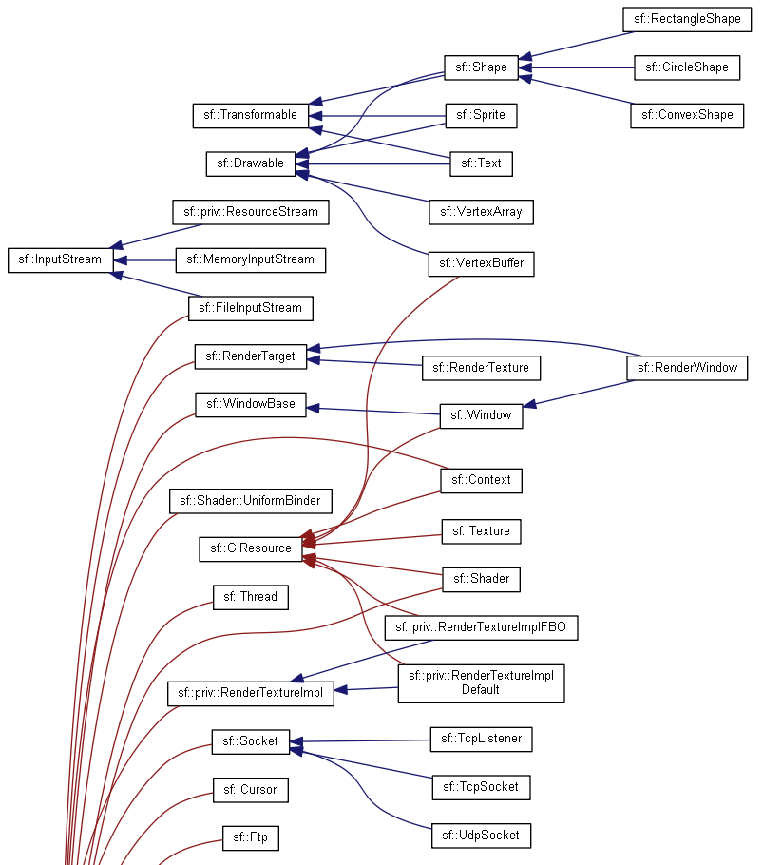
real-world example:
SMFL

Slide 17
note that we still haven't written any actual code we've made a plan for how to break the problem into objects

Slide 18
note: it can be hard to break problems into objects
Consider a very basic question: should a Message send itself? ‘Sending’ is a key thing I wish to do with Messages, so surely Message objects should have a ‘send’ method, right? If Messages don’t send themselves, then some other object will have todo the sending, like perhaps some not-yet-created Sender object. Or wait, every sent Message needs a Recipient, so maybe instead Recipient objects should have a ‘receive’ method. This is the conundrum at the heart of object decomposition. Every behavior can be re-contextualized by swapping around the subject, verb, and objects. Senders can send messages to Recipients; Messages can send themselves to Recipients; and Recipients can receive messages. --Brian Will

Slide 19
so

Slide 20
it is very hard to break a problem into objects

Slide 21
but

Slide 22
it is also very popular to break a problem into objects

Slide 23
so let's learn some OOP 🙂👍

Slide 24
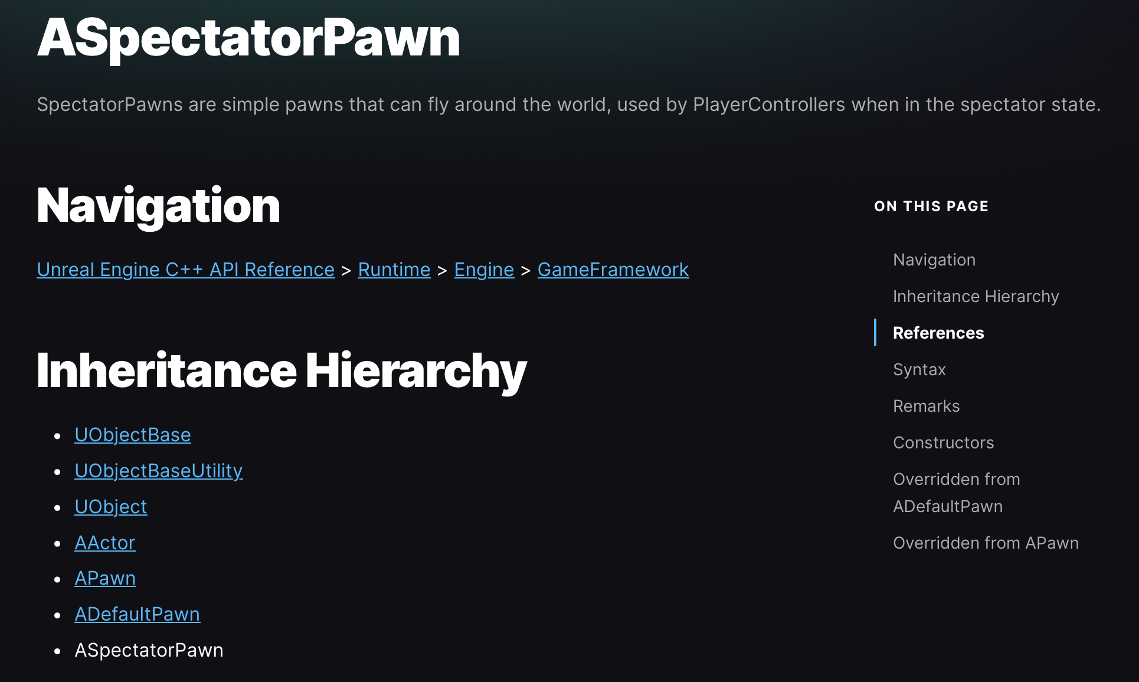
example: Unreal Engine API

Slide 25
example: PyTorch

Slide 26
inheritance

Slide 27
one class can inherit from another
a child class (derived class, subclass) inherits from its parent class (base class, superclass)
a child inherits (gets, has) its parents' variables and functions
// Inheritance: HW13 is a Cow (app)
class HW13 extends Cow {
public static void main(...) {
while (beginFrame()) {
...
}
}
}
class Cow {
static boolean beginFrame(...);
static double mouseX;
static double mouseY;
static boolean keyPressed(...);
...
}

Slide 28
inheritance is convenient, but NOT fundamental (except sometimes in Java)
instead of extending a class, we can store a reference to an instance of it
this is called "composition"
we will have to use the dot operator (a lot) more, but c'est la vie; they're fundamentally the same thing*
// Inheritance: HW13 is a Cow
class HW13 extends Cow {
public static void main(...) {
while (beginFrame()) {
...
}
}
}
// Composition: HW13 has a Cow
class HW13 {
static Cow cow;
public static void main(...) {
while (cow.beginFrame()) {
...
}
}
}

Slide 29
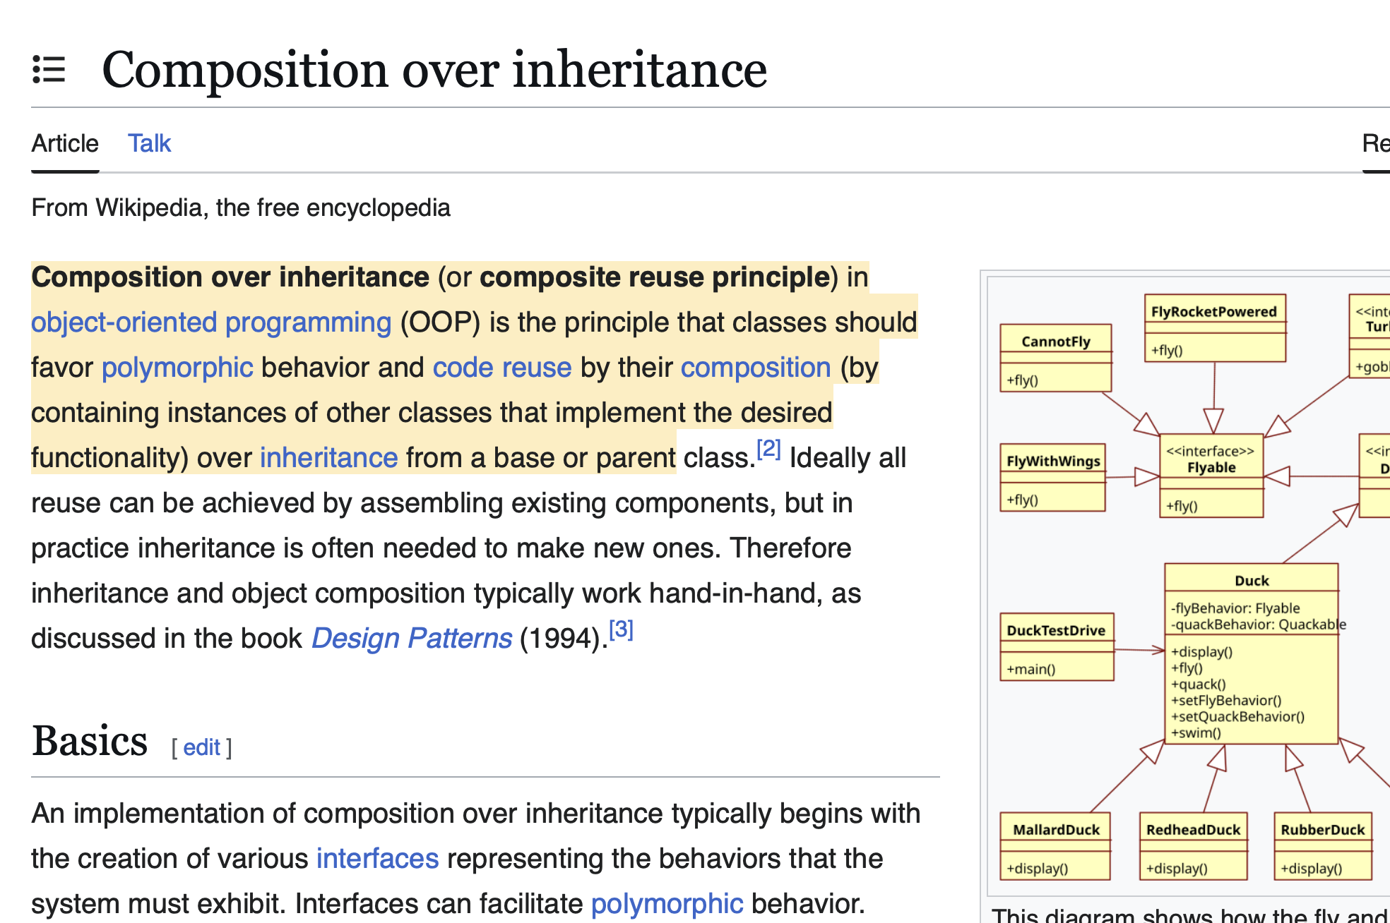
*sidenote: some people don't think agree with me that composition and inheritance are the same thing

Slide 30
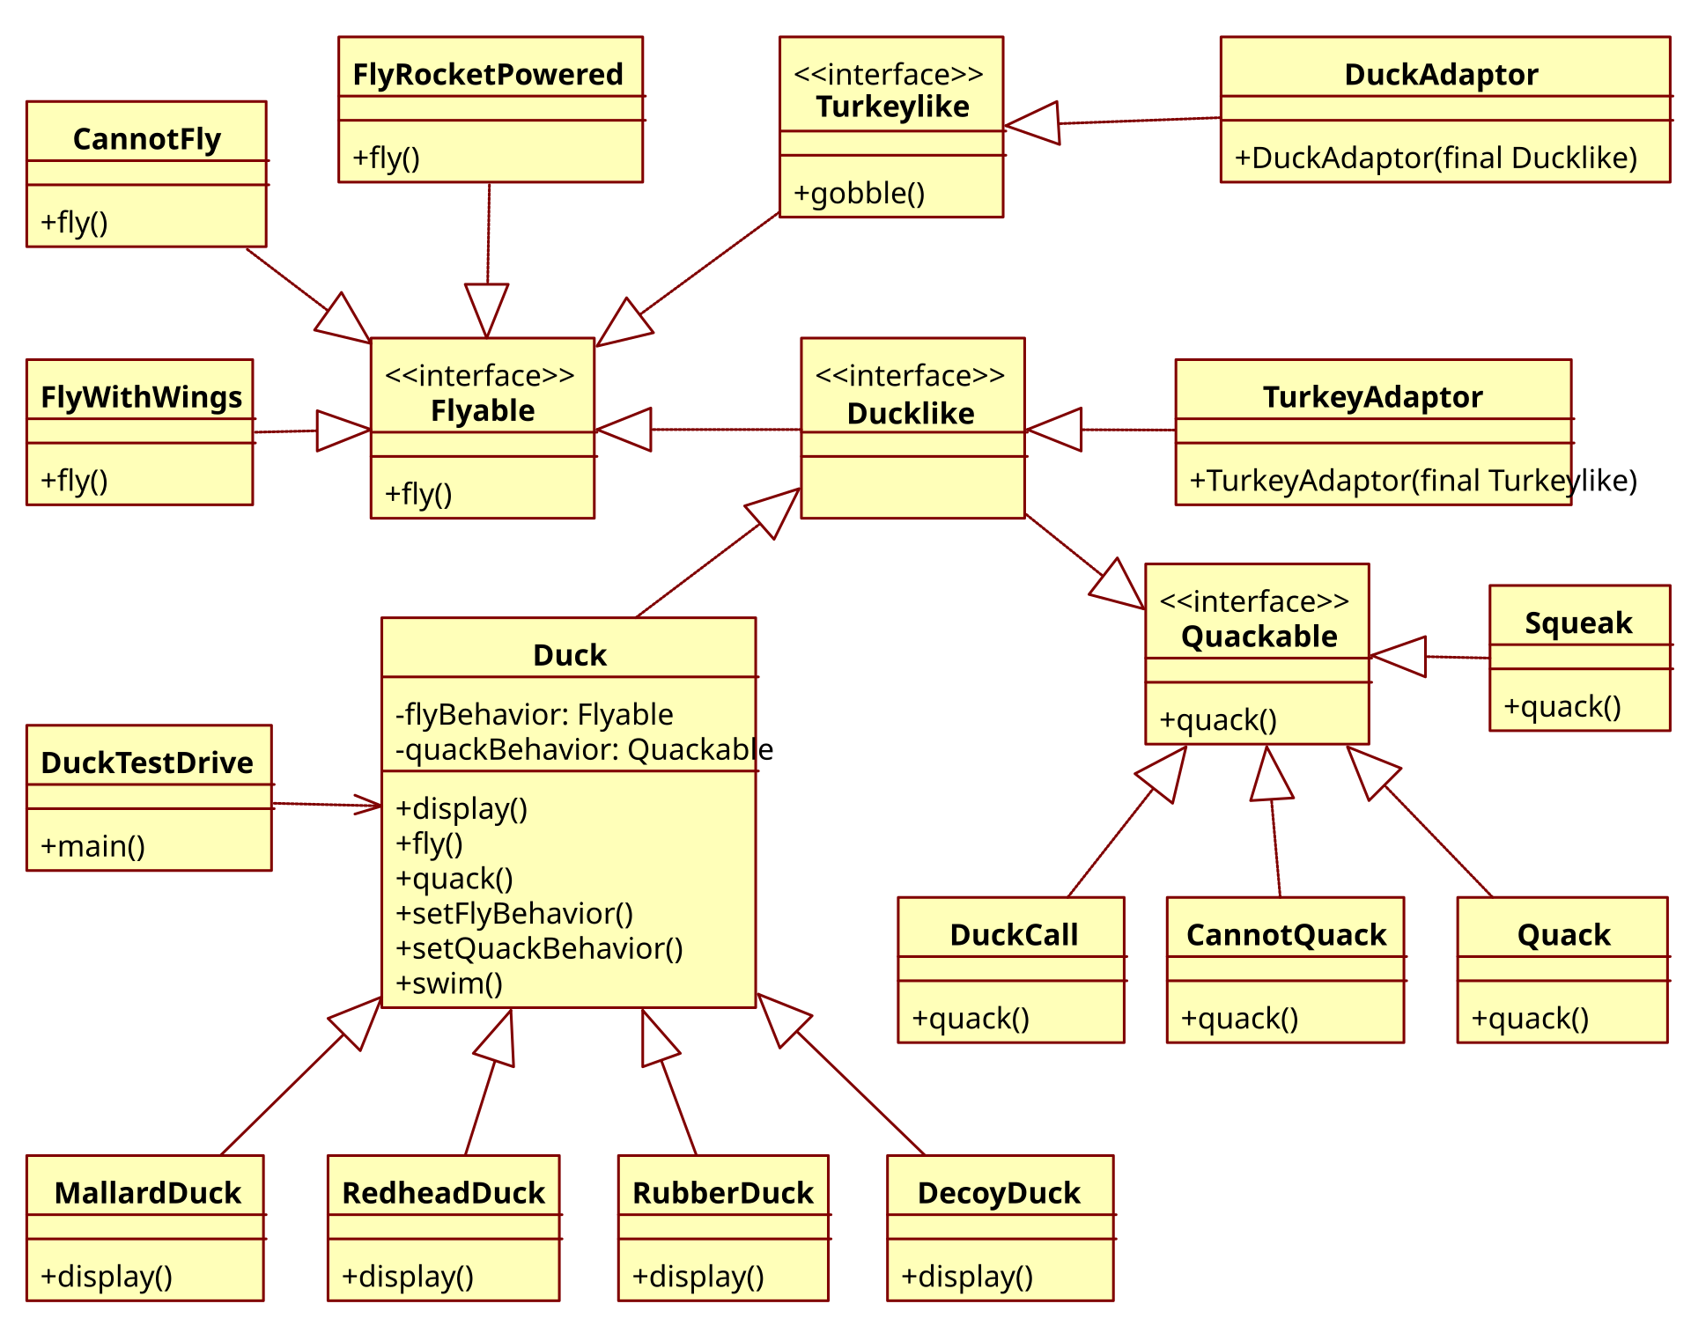

Slide 32
🦃

Slide 33
gobble gobble

Slide 34
anyway.

Slide 35
the fundamental point is that maybe it's nice to reuse code

Slide 36
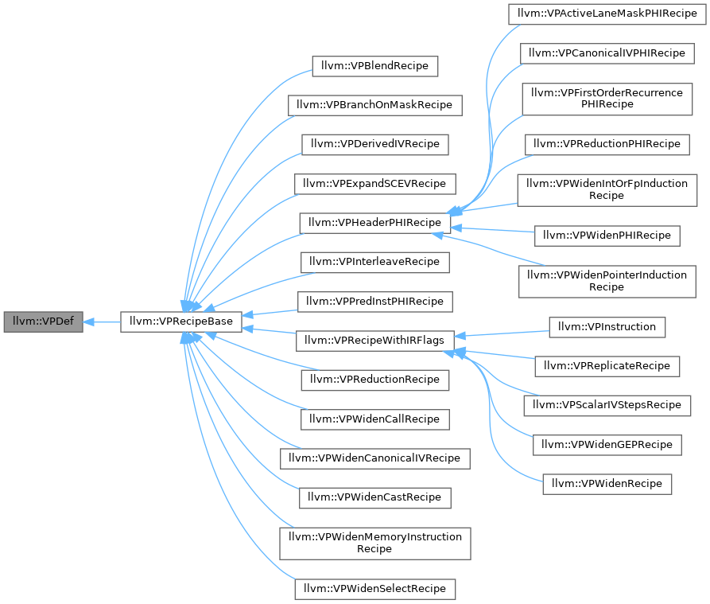
maybe

Slide 37
final note: inheritance doesn’t simplify a problem so much as i t s p r e a d s i t o u t (and spreads it around?)

Slide 38
down the rabbit hole...
public class ArrayList<E>

Slide 39
down the rabbit hole...
public class ArrayList<E> extends AbstractList<E>
implements List<E>, RandomAccess,
Cloneable,
java.io.Serializable

Slide 40
down the rabbit hole...
public abstract class AbstractList<E> extends AbstractCollection<E>
implements List<E> {

Slide 41
down the rabbit hole...
public abstract class AbstractCollection<E> implements Collection<E> {

Slide 42
down the rabbit hole...
public interface Collection<E> extends Iterable<E> {

Slide 43
down the rabbit hole...
public interface Iterable<T> {
/**
* Returns an iterator over a set of elements of type T.
*
* @return an Iterator.
*/
Iterator<T> iterator();
}

Slide 44
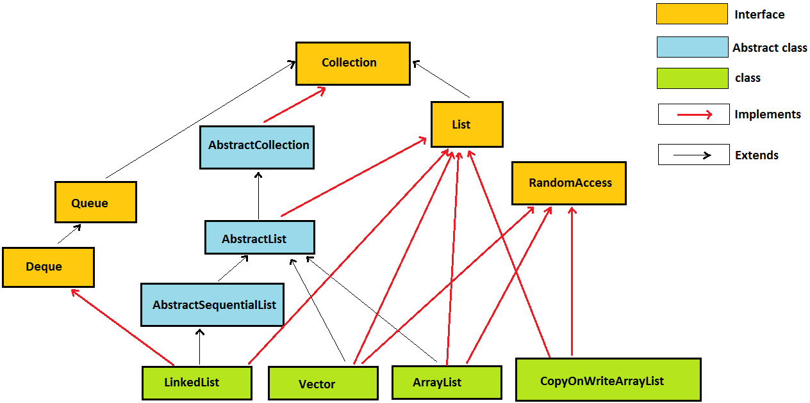
down the rabbit hole...

Slide 45
gobble gobble

Slide 46
encapsulation

Slide 47
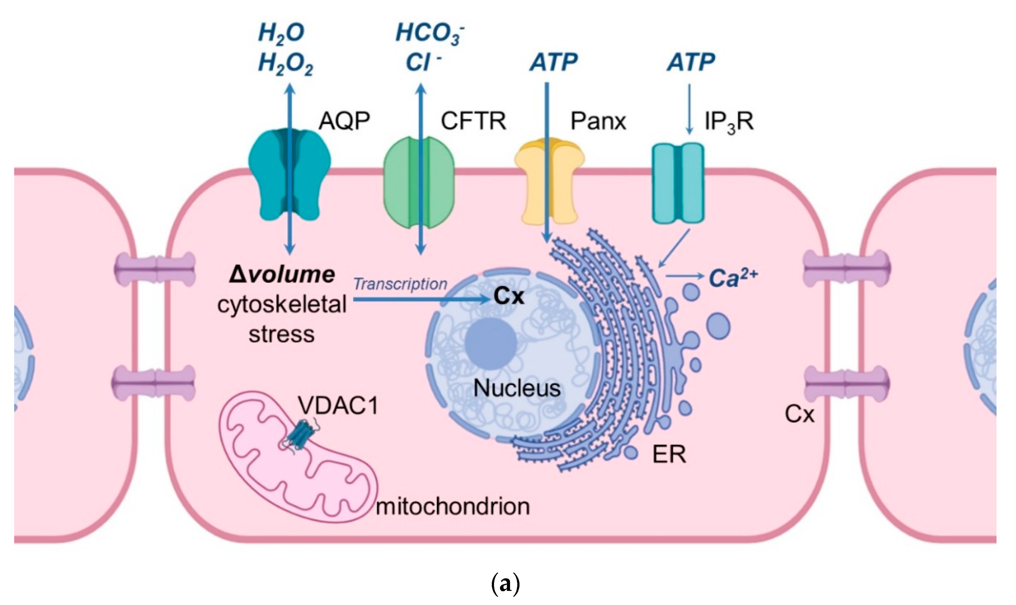

Slide 48
encapsulation
encapsulation is the idea that a class should be like a "capsule"
the variables inside the capsule should be private
users of the class CANNOT touch them
for its users, the class should expose safe, public functions

Slide 49
void put(KeyType key, ValueType value) { ... }
ValueType get(KeyType key) { ... }
int size() { return this._size; }
ArrayList<KeyValuePair>[] buckets;
int _size;
encapsulated hashmap

Slide 50
note: this probably makes sense the typical user of a hashmap shouldn't be messing with the private array (and perhaps the exceptional user should write their own hashmap)

Slide 51



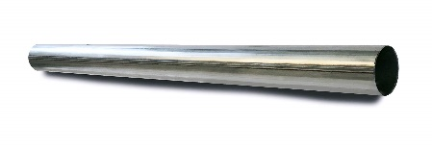

big idea: encapsulation can hide away messy, dangerous details
note: this is just a metaphor;
do NOT play with fire

Slide 52
however encapsulation can maybe be taken too far
bullet.age++;
bullet.setAge(bullet.getAge() + 1);
bullet.ageUp(); // ?

Slide 53
OOP considered maybe mildly frictious to prototyping

Slide 54
final note: encapsulation doesn’t add functionality encapsulation removes functionality

Slide 55
special topic: conway's law

Slide 56
[O]rganizations which design systems (in the broad sense used here) are constrained to produce designs which are copies of the communication structures of these organizations. — Melvin E. Conway, How Do Committees Invent?

Slide 57
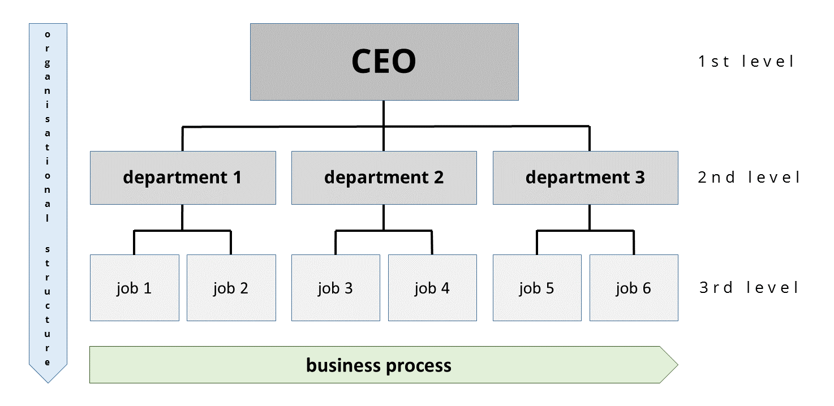

Slide 59
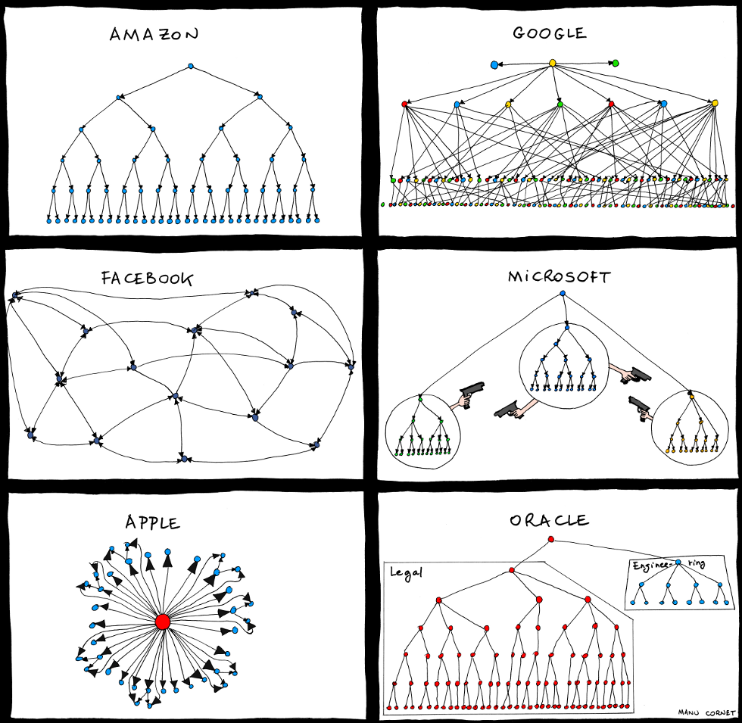

Slide 60
spicy take 🌶️

Slide 61
iterators

Slide 62

W E E K 1 3 b
T O D A Y
is Wednesday
W A R M U P
what is a computer program?
what is programming?
what is a data structure?

Slide 63

🌞
Week13b
TODAY
final exam logistics
Fun Kahoot Wednesday Final Review
also doughnuts
WARMUP
what is a computer?
what is a computer program?
what is programming?
what is data?
what is a data structure?
🦜🦜🦜🦜🦜🦜🦜🦜🦜🦜🦜🦜

Slide 64
final exam logistics

Slide 65
final exam logistics

Slide 66
final exam
the 2 hour final exam will be Sun, Dec 15, 1:30 PM in TCL 123 (Wege)
if you have a conflict (exam hardship, international travel), and talk to me by the end of day today, then you take the final exactly 24 hours early (same location, same time)
the final exam covers data structures and (A-, A) HW from after the midterm
from PostScript to Recursion + Dynamic Programming
note: you will still need to know some stuff from the first half of the course
Java syntax
what is an array
etc.

Slide 67
what has this course been about?

Slide 68
data structures & big O runtime as i review... use the big O runtimes to remind yourself how the data structures work 🙂👍

Slide 69
pop quiz: what is the most important data structure?

Slide 70
quadtree

Slide 71
just kidding

Slide 72
it's the arrayyyyy

Slide 73
array

Slide 74
(also trees, but really mostly arrays.)

Slide 75
data structures

Slide 76
array, string

Slide 77
an array is a sequence of contiguous elements
the length of an array is fixed
⏱️ creating an array takes O(n) time, where n is the length of the array
because the elements are all the same size and all right next to each other, accessing an array is FAST
⏱️ getting the value of the i-th element of an array takes O(1) time
⏱️ setting the value of the i-th element of an array takes O(1) time

Slide 78
a string is internally an array of characters
⏱️ adding (concatenating) two strings of length n is an O(n) operation
we have to make a new string of length 2n, which is O(n)

Slide 79
array list

Slide 80
we used an array to implement an array list, which automatically resizes itself
⏱️ when the internal private array is not full, adding (to the end) is O(1)
⏱️ when the internal private array is full, adding is O(n)
have to make a new array (of, for example, twice the length) and copy

Slide 81
stack, queue, hash map

Slide 82
we used an array list to implement a stack and a queue
stacks and queues restrict the way we access a sequence of elements
a stack can push an element to the top & pop the top element
🥞
a queue can add an element to the back & remove the front element
🚶‍♀️🚶‍♂️🚶‍♀️🚶‍♀️🚶‍♂️🚶‍♂️🚶‍♂️

Slide 83
we can use an array of array lists to implement a hash map
⏱️ putting (adding) a key-value pair into a hash map is (amoritzed) O(1)
it's a "slow O(1)," which involves hashing the key
in separate chaining (like we did in class), this takes us to a bucket
if the key was already in the bucket, we overwrite its value
otherwise we add the key-value pair to the bucket
⏱️ get key's value from a hash map is O(1)

Slide 84
node, linked list, tree, binary tree, binary search tree, heap

Slide 85
a node is a little teeny class
a node can store data (like a value) as well as references to other nodes

Slide 86
a chain of nodes is a linked list
a linked list has the same interface as an array list, but acts very differently
⏱️ adding to the end of a singly linked list is O(n)
⏱️ getting an element by index is O(n) ☹

Slide 87
a branching chain of nodes (with no cycles) is a tree
each node has references to its children
a node's children & its children's children & its children's children's children, ... are called its descendants
the node with no parents is called the root

Slide 88
a tree where each node can only have up to two children is a binary tree
a node in a binary tree can have a left child and a right child
the height of a balanced binary tree is O(log n)

Slide 89
binary search trees and heaps are special kinds of binary trees
in a binary search tree, each node's value is greater than the values of all of its left descendants and less than the values of all of its right descendants
⏱️ searching a balanced binary search tree is O(log n)
in a max binary heap, each node's value is greater than the values of both of its children
⏱️ adding an element to a max binary heap is O(log n)
🐡 add to the first empty slot and swim up
⏱️ removing the max element (root) from a max binary heap is O(log n)
⚓ swap the last element with the root and sink down

Slide 90
🦉

Slide 91
🦉 kahoot

Slide 92
🦉 kahoot !

Slide 93
what does it all mean?

Slide 94
what does it all mean?

Slide 95
here's my attempt to summarize the course in a few sentences

Slide 96
136
data means numbers (letters are numbers, colors are numbers, ...)
there's no one perfect way to organize your data
it depends on the problem
to find a good data structure for a particular problem, we can...
...just try an array first; if that works, great, we're done 🙂👍
...compare different data structures using math (big O notation)
...in terms of speed
...in terms of space
...compare different data structure's usage code
...an array might be fast, but is it pleasant?

Slide 97
136 was us moving from finding a solution... ...to finding a good solution

Slide 98
and starting to build the tools and confidence to solve bigger problems 💪🙂

Slide 99
for example, the final project 😬👍

Slide 100
homework ✨ how do the post-midterm homeworks work? can you "run them by hand?"

Slide 101
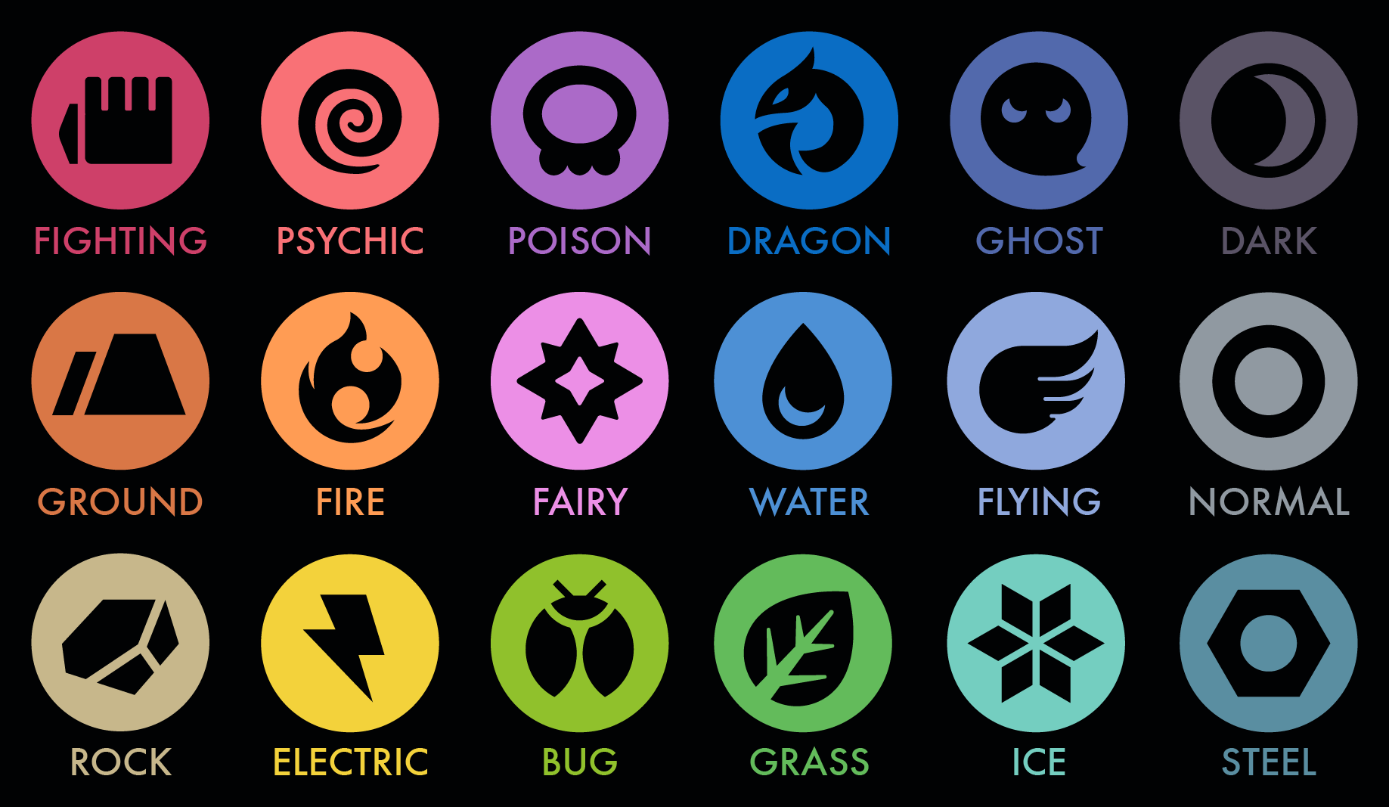
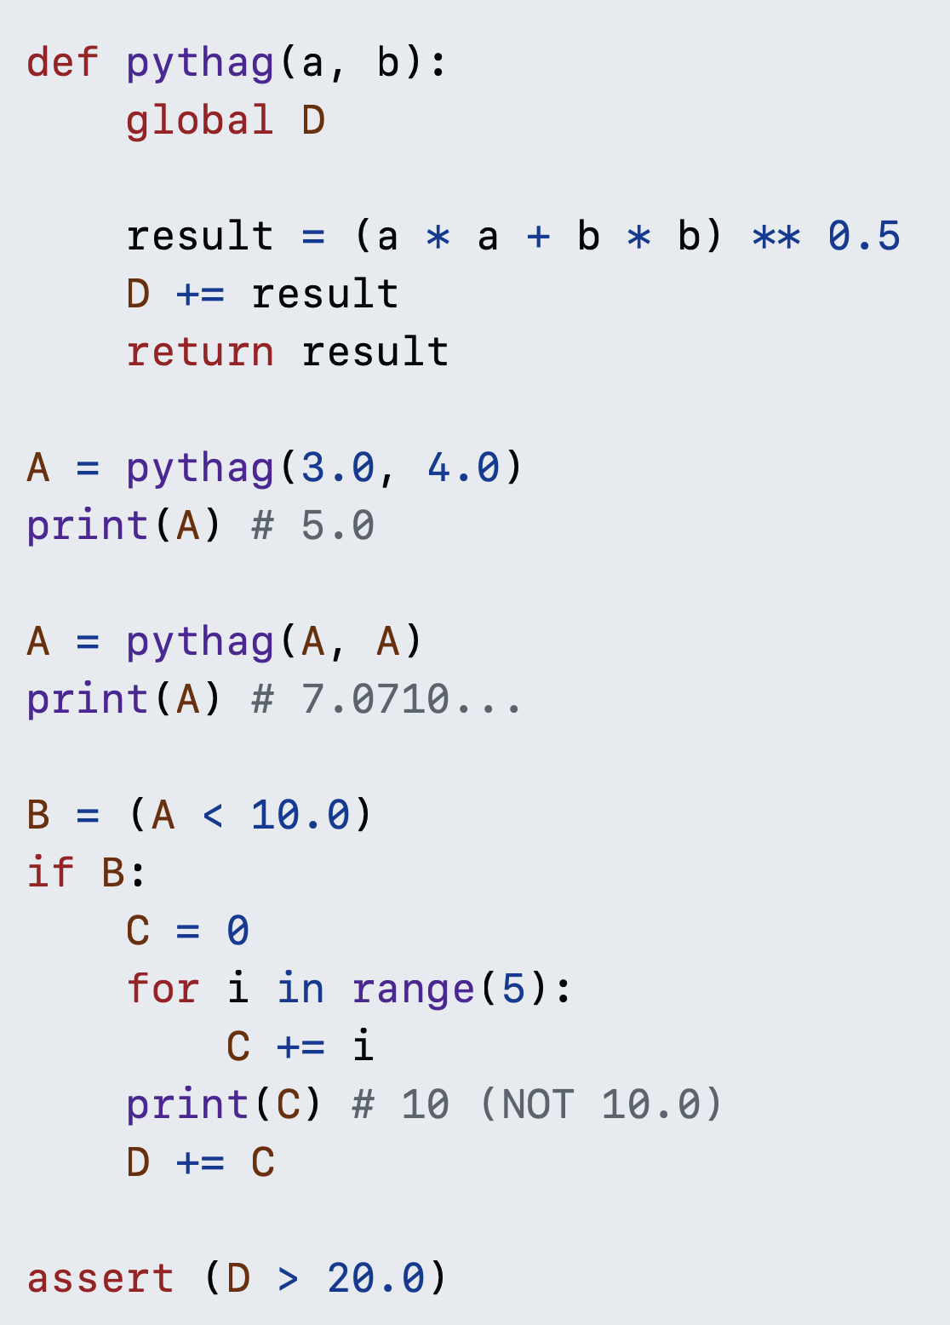
1
int

Slide 102

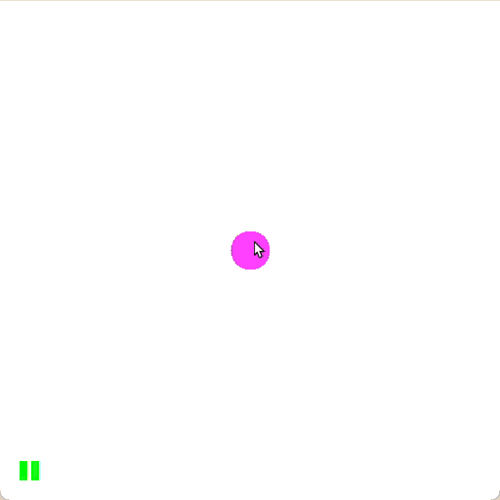

Slide 103
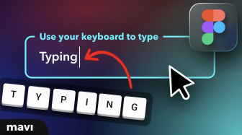


Slide 104

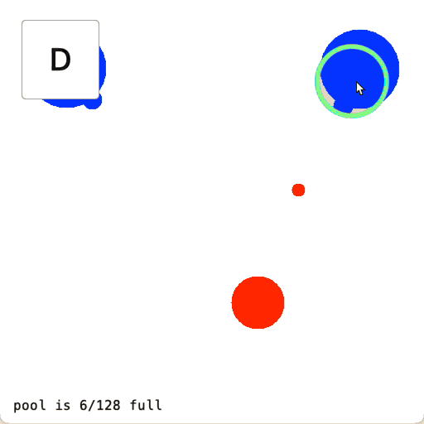

Slide 105

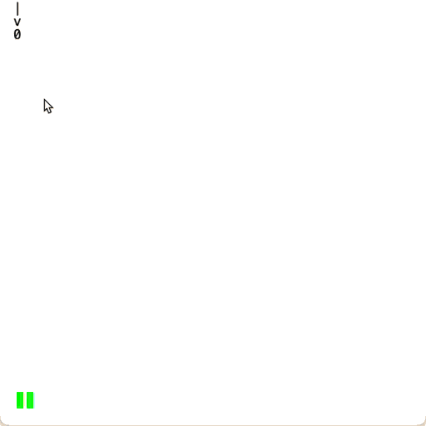

Slide 106

how do you interpret PostScript?

Slide 107

how do you generate text?

Slide 108
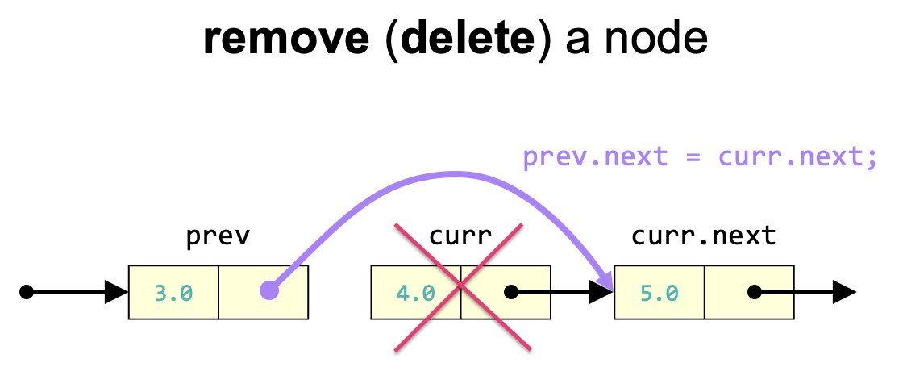
how do you create
& change a linked list?

Slide 109
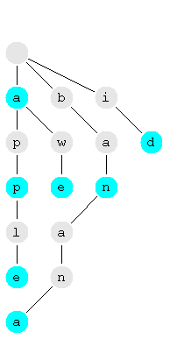
how do you store a vocabulary in a tree (trie)?

Slide 110
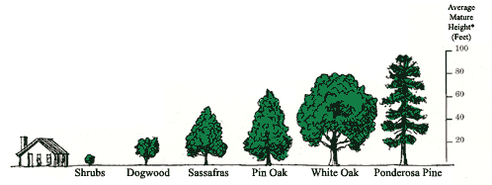
how can i search and sort?

Slide 111
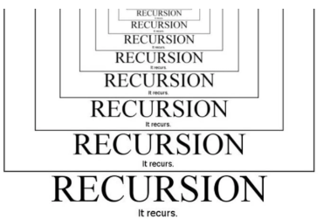
what is the big O runtime of a piece of code?

Slide 112
questions

Slide 113
what does it all mean?

Slide 115
what does it all meme?

Slide 116


Slide 117
increment operator
to "increment" means to increase the value of a number by one
i = i + 1;
i += 1;
the pre-increment ++i increments i and returns the new value of i
j = ++i; // i = i + 1;
// j = i;
the post-increment i++ increments i and returns the old value of i
j = i++; // j = i;
// i = i + 1;

Slide 118
decrement operator
to "decrement" means to decrease the value of a number by one
i = i - 1;
i -= 1;
the pre-decrement --i decrements i and returns the new value of i
j = --i; // i = i - 1;
// j = i;
the post-decrement i-- decrements i and returns the old value of i
j = i--; // j = i;
// i = i - 1;

Slide 119
story time ☕️

Slide 120
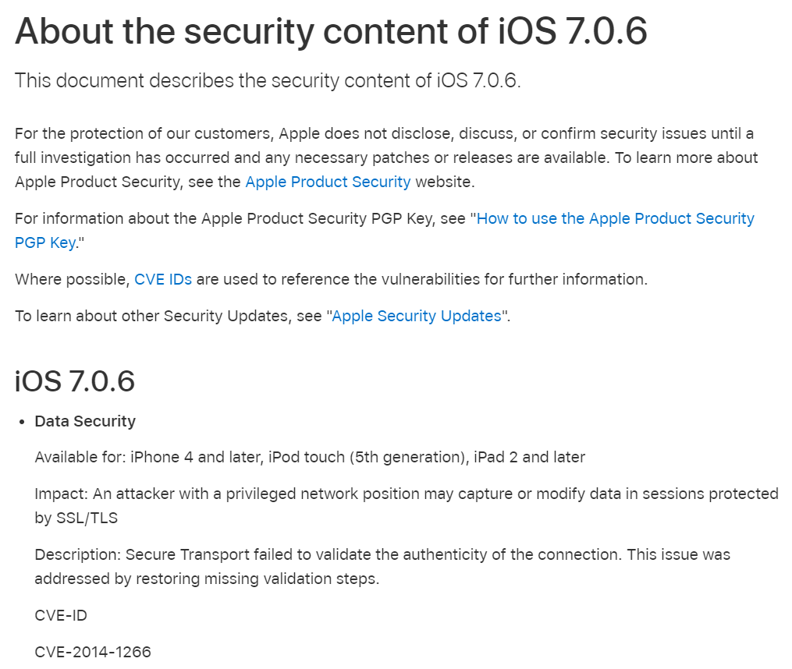

Slide 121
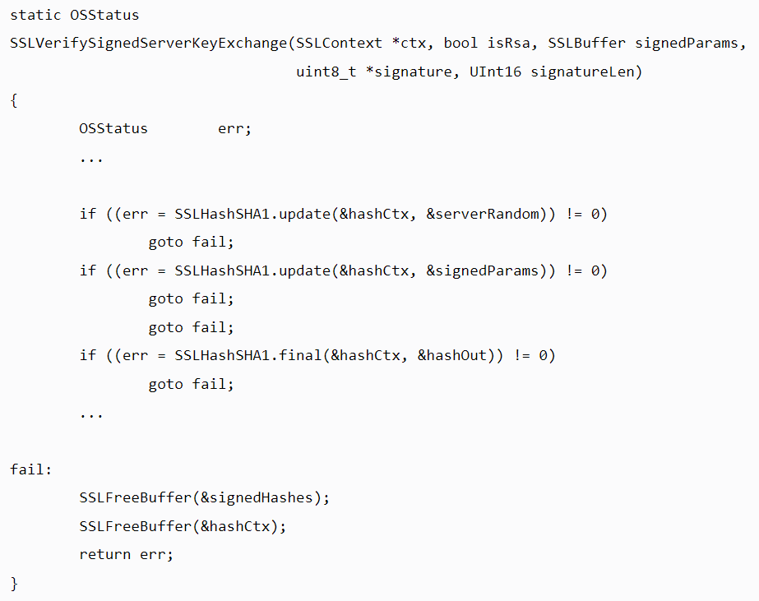

Slide 122
{
}
goto fail;

Slide 123
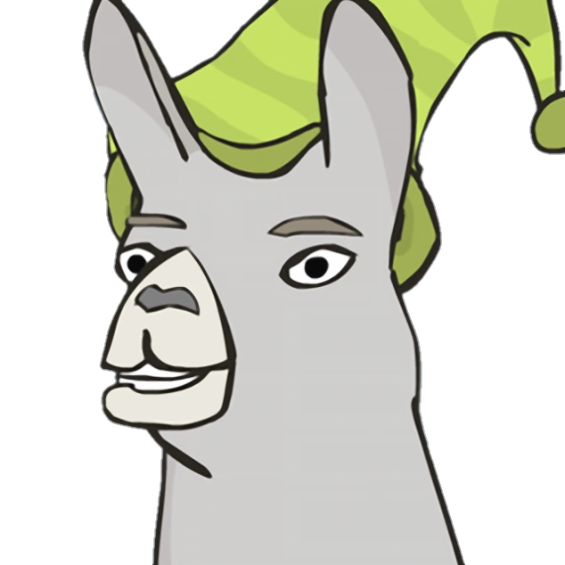
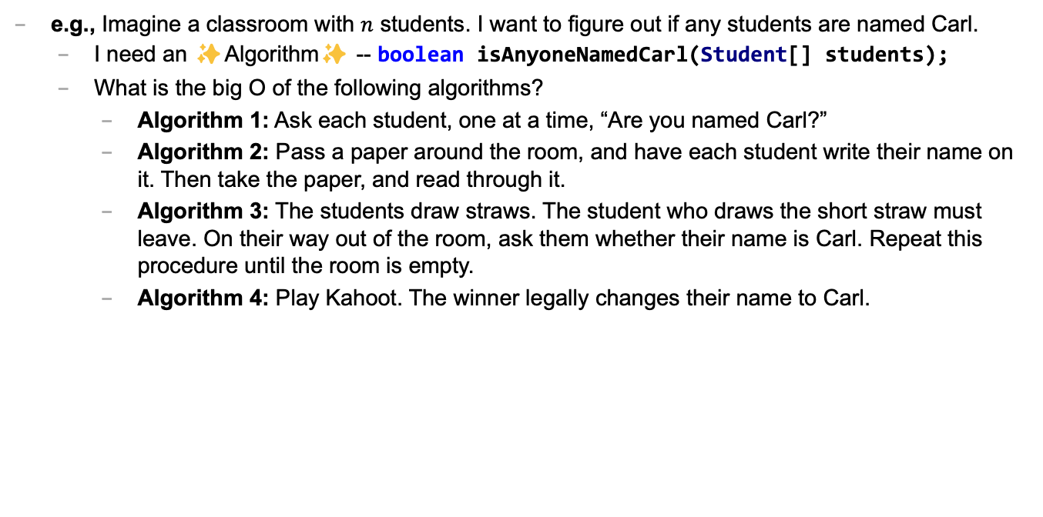
Caaaaaaaaaaaarl
e.g., Imagine a classroom with $n$ students. I want to figure out if any students are named Carl.
I need an ✨Algorithm✨ -- boolean isAnyoneNamedCarl(Student[] students);
What is the big O of the following algorithms?
Algorithm 1: Ask each student, one at a time, “Are you named Carl?”
Algorithm 2: Pass a paper around the room, and have each student write their name on it. Then take the paper, and read through it.
Algorithm 3: The students draw straws. The student who draws the short straw must leave. On their way out of the room, ask them whether their name is Carl. Repeat this procedure until the room is empty.
Algorithm 4: Play Kahoot. The winner legally changes their name to Carl.

Slide 124
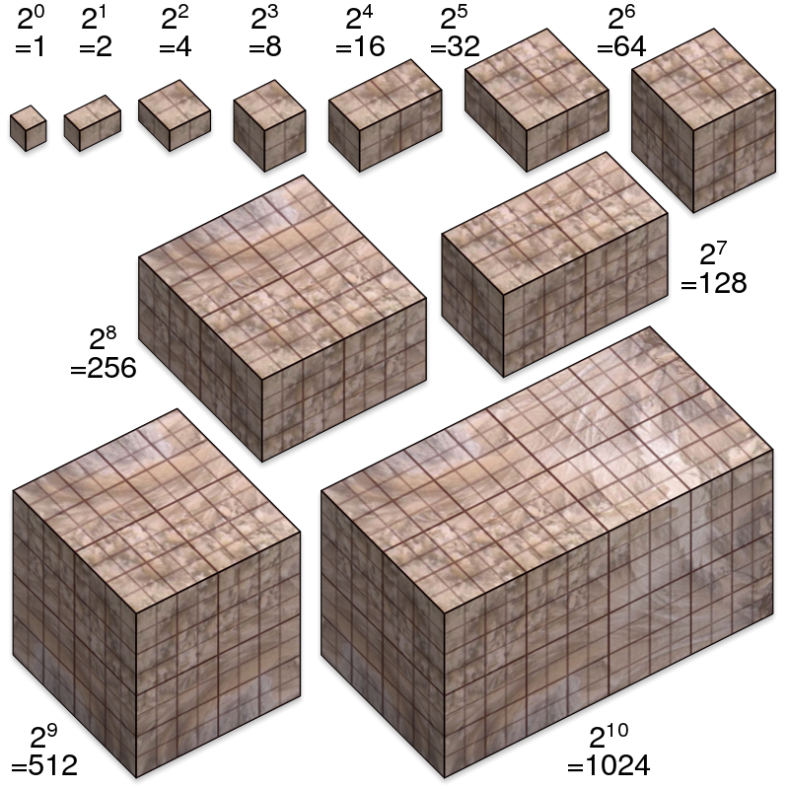
not broken
broken
developing one thing at a time

Slide 125
not broken
A is broken
B is broken
A and B are both broken
developing two things at a time

Slide 126

asymptotic bug-finding time

Slide 127
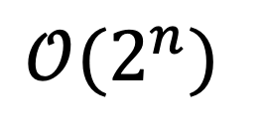
$$𝒪(2^{n})$$
gl;hf 🙂👍

Slide 128

compilers

Slide 129

DOCUMENTATION

Slide 130
Tungsten break 😀 did you know the density of Tungsten is 19.25 g/cm³? Gold is 19.32 g/cm³ did you know Tungsten is really hard? Tungsten alloys can be as hard as Sapphire! that's really hard! Tungsten is expensive (that cube is $60) but not like...that expensive what could YOU do with Tungsten?

Slide 131
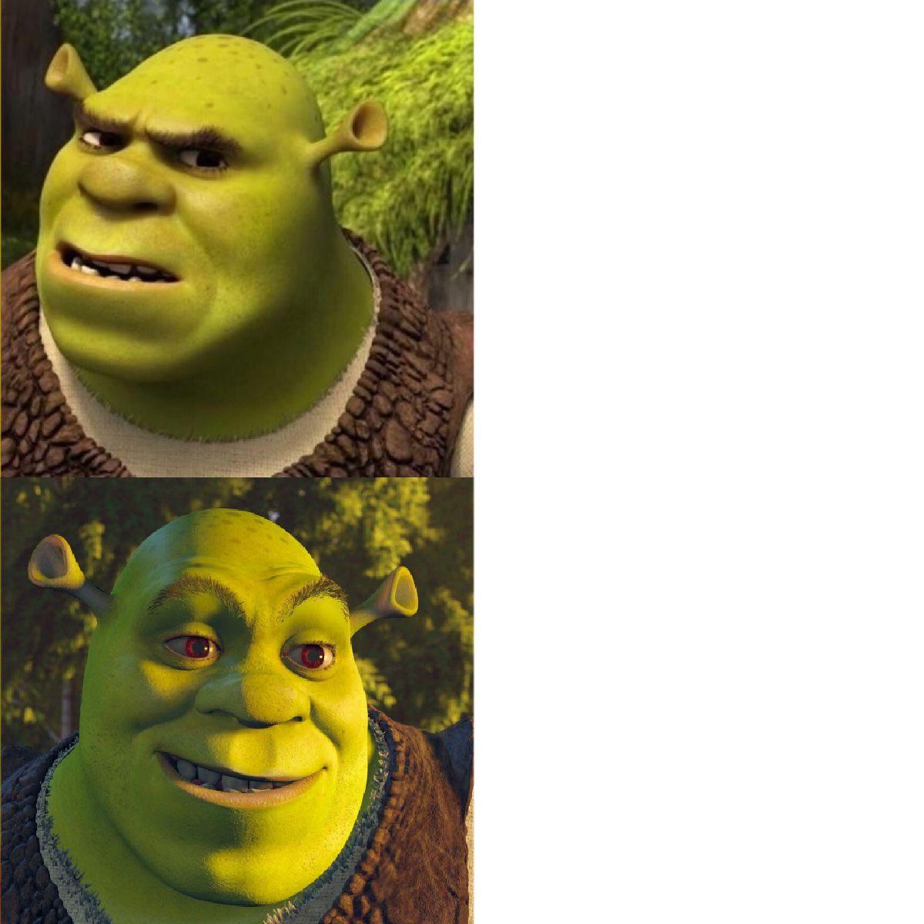
if (token.type == 2) {
...
}
if (token.type == Token.TYPE_STRING) {
...
}

Slide 132
🐧🦉
🦜
🐤
🪣
🪣
🐦
🦆🐓🦃
🪣
🪣
🪣
Joe Kahoot Cheep Hans Doug Io Gary Max
0
1
2
3
4
👮

Slide 133
🐍
3.0
head
|
|
head.next
|
|
|
|
|
null

Slide 134
"the stack"
local variable primitives & references to Objects
undefined by default (will NOT compile if used)
"the heap"
the actual Objects (arrays and String's count as Objects)
cleared to 0 or null by default

Slide 136
LinkedList list;
{
Node node;
String string;
list = new LinkedList();
node = new Node();
string = "Hans";
node.value = string;
list.head = node;
node = new Node();
string = "Parrot";
node.value = string;
list.head.next = node;
}
list
0x11111111
0x22222222
0x88888888 0x33333333
0x99999999 null
H a n s
P a r r o t

Slide 137
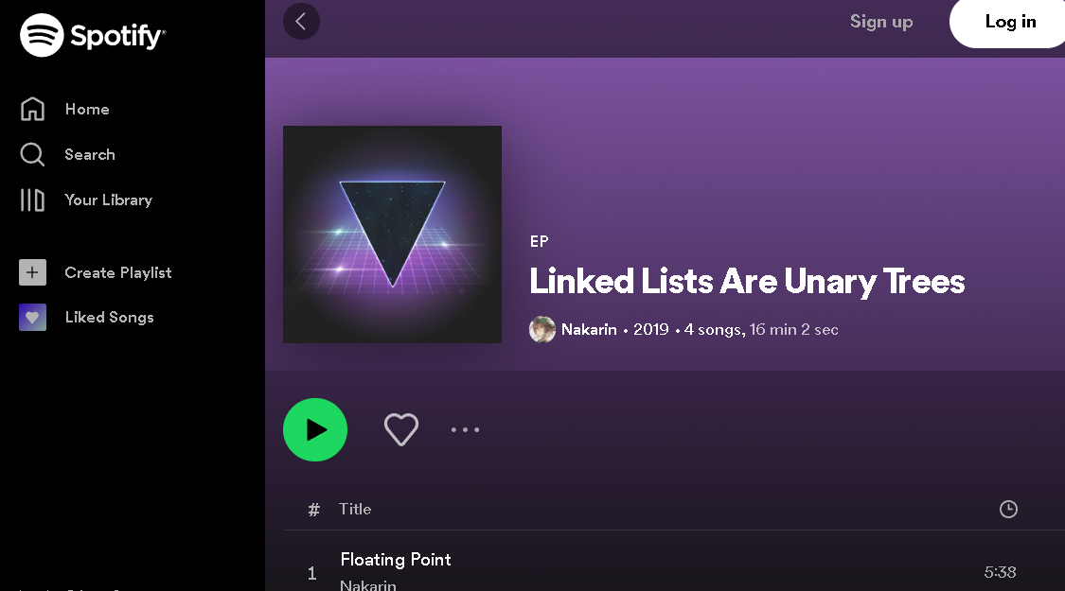
can be seen as

Slide 138
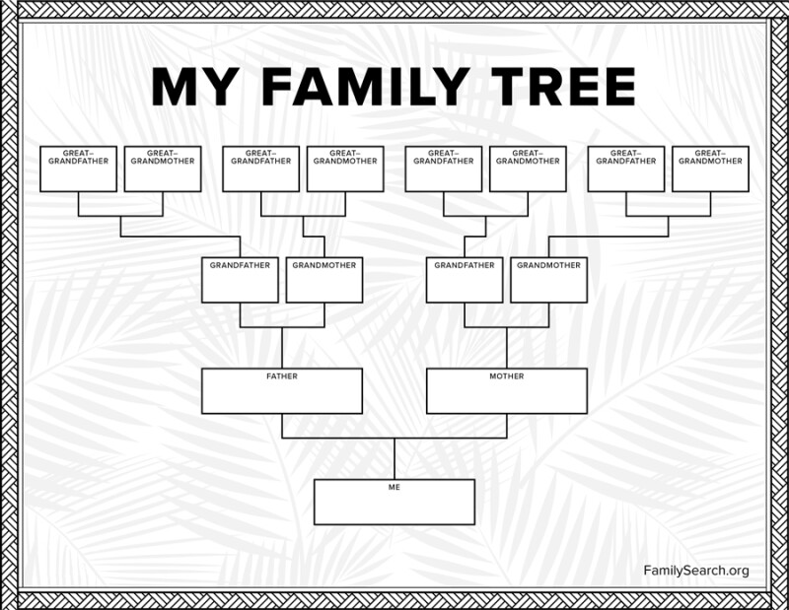

Slide 140
jim
careful: these nodes are
the children of the node with value jim
jim's mom
jim's dad
jim's mom's mom
jim's mom's dad
jim's dad's mom
jim's dad's dad

Slide 141



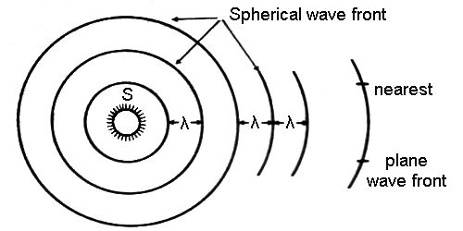
breadth-first vs. (pre-order) depth-first
"a persistent, optimistic, very thorough worm" –Mark Hopkins

Slide 142
quadtree rabbit hole 🐰

Slide 143

2 * 3
+ 4
who's that
traversal order?
+
in-order!
*
4
2
3

Slide 144
[ 7 4 2 3 6 1 8 5 9 ]
7
4
2
3

Slide 145
[ 7 4 2 3 6 1 8 5 9 ]
7
4
2
🐡
3
6

Slide 146
[ 7 6 2 3 4 1 8 5 9 ]
7
6
💦
2
3
4

Slide 147





extension: priority queue
priority 9
priority 1
priority 1
priority 5

Slide 148

extension: priority queue
priority 999
priority 9
priority 1
priority 1
priority 5

Slide 149
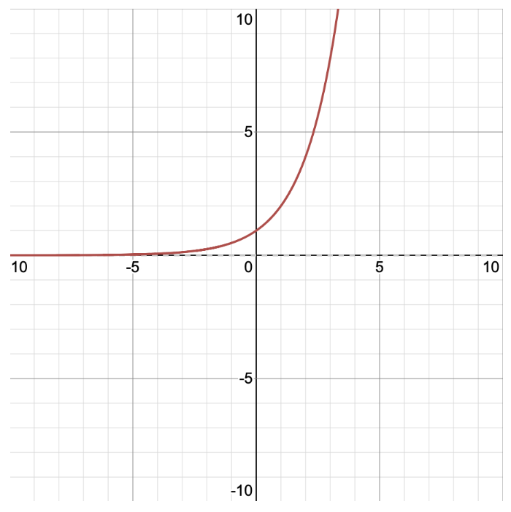
y = 2^{x} x = log₂ y
y
x

Slide 150
y = 2^{x} x = log₂ y
y
x

Slide 151
🙂👍

Slide 152
🥲👍

Slide 153
questions

Slide 154
Week?12🦃
graphs
amazing stackoverflow answer
boggle?
gradient descent

Slide 155
graphs

Slide 156
graph

Slide 157
a directed graph is a super general linked list
a node in a graph has references to any number of other nodes
nodes (vertices) are drawn as circles
references (edges) are drawn as arrows

Slide 158
an undirected graph has line segments instead of arrows

Slide 159
is it a graph?

Slide 160
time for everyone's favorite home game...

Slide 161
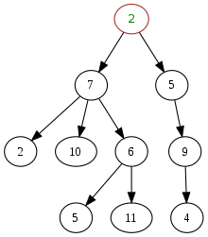
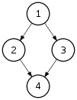
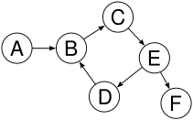
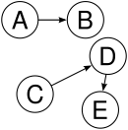

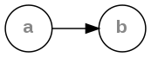
is it a tree?
graph
yes
yes
tree rules
one node with zero parents
no node with more than one parent
no cycles
is connected
yes
yes
yes
yes
yes

Slide 162
yes

Slide 163
examples

Slide 164
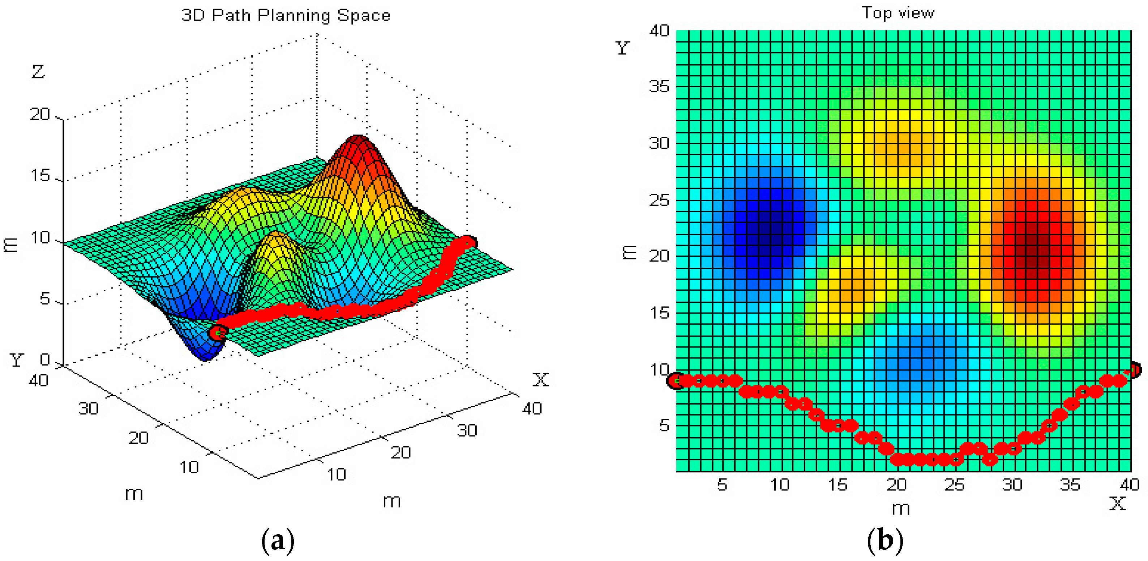

path planning

Slide 165
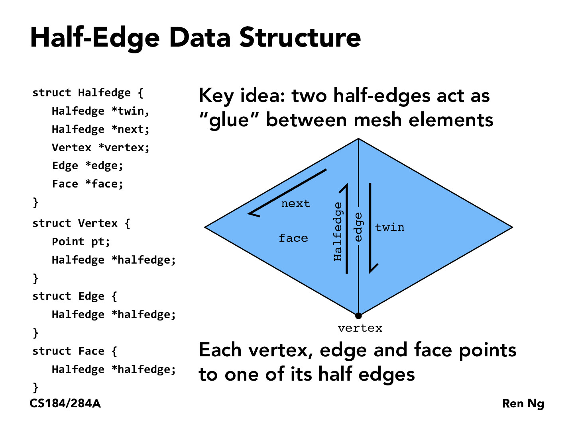
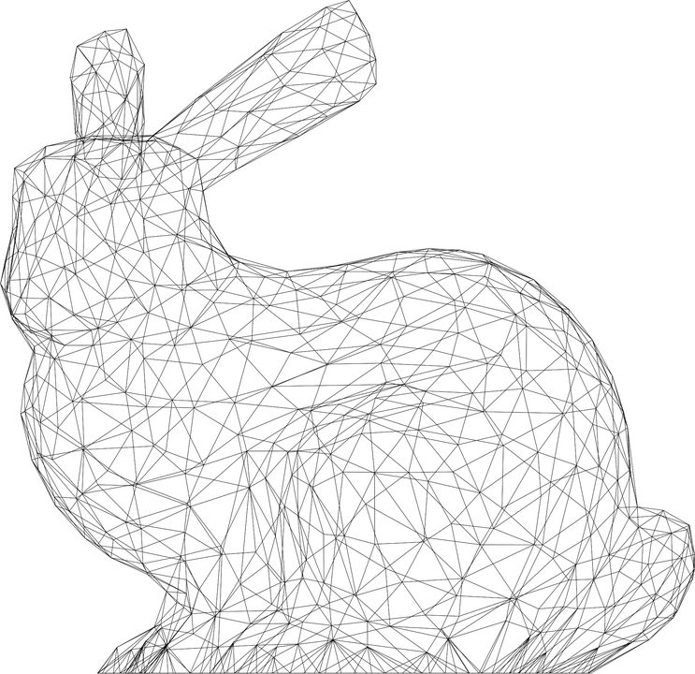

Slide 166
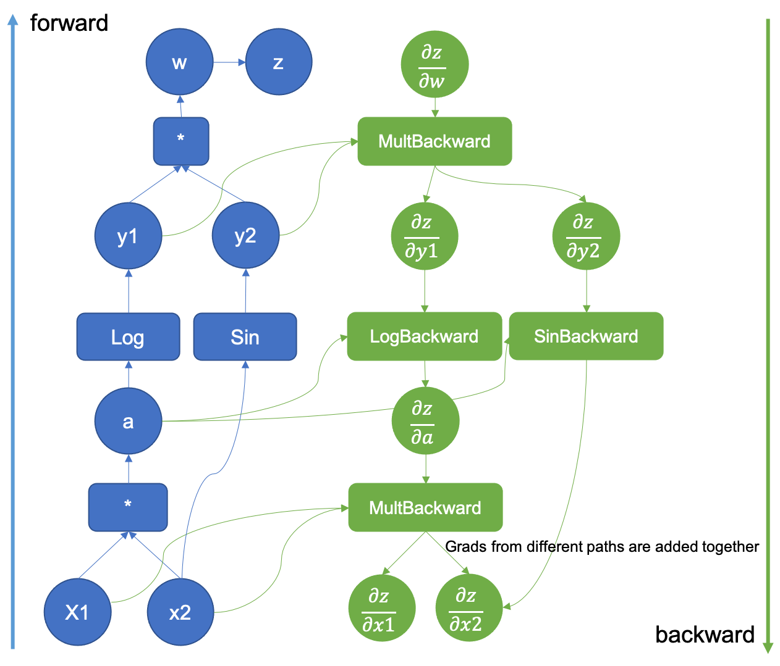

computational
graph
(to take derivatives of deep nets)

Slide 167

Yeah that's pretty much right --Mark
Is this an accurate quote?
--Jim
Yeah, sure
--Mark

Slide 168
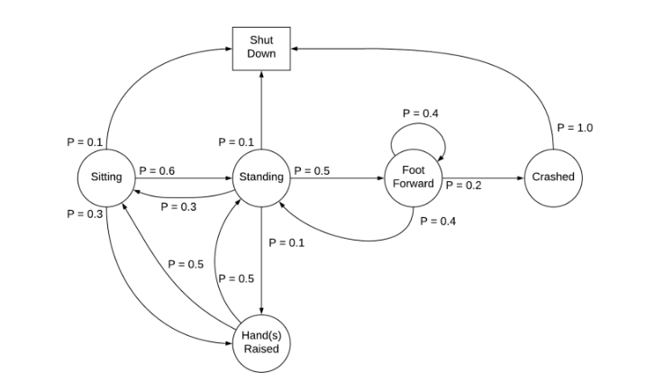
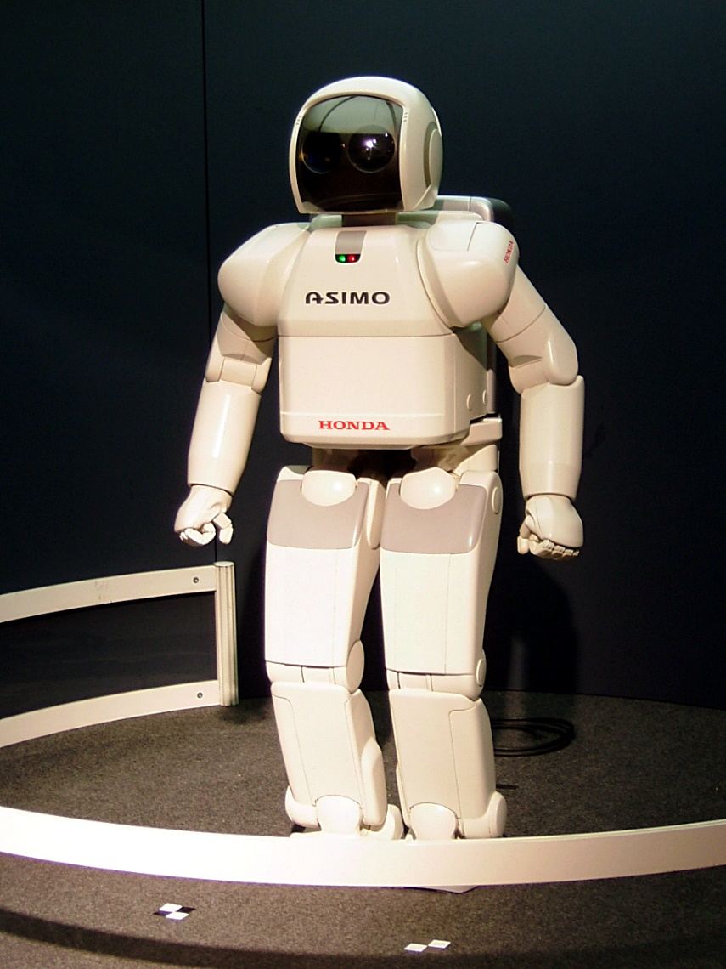
Markov Decision Process

Slide 169
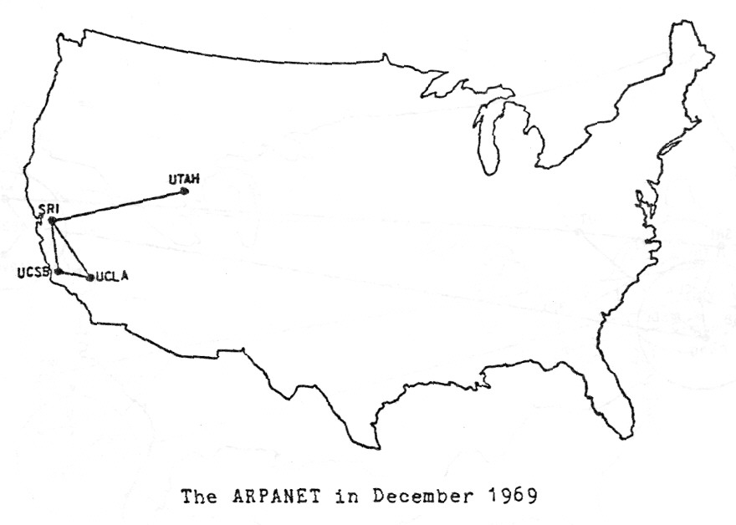

Slide 170

Present day, from Opte The Internet: 1997 - 2021. VIDEO: BARRETT LYON/THE OPTE PROJECT

Slide 171
directed graph representations (how do i store The Data?)

Slide 172
0
1
3
2

Slide 173
Object-Oriented list of nodes
class Graph {
ArrayList<Node> nodes;
Graph() { ... }
}
class Node {
ArrayList<Node> neighbors;
Node() { ... }
}
Graph graph = new Graph();
graph.nodes.add(new Node());
graph.nodes.add(new Node());
graph.nodes.add(new Node());
graph.nodes.add(new Node());
graph.nodes.get(1).neighbors.add(graph.nodes.get(0));
graph.nodes.get(1).neighbors.add(graph.nodes.get(3));
graph.nodes.get(2).neighbors.add(graph.nodes.get(3));
graph.nodes.get(3).neighbors.add(graph.nodes.get(0));
0
1
3
2

Slide 174
Object-Oriented list of nodes
class Graph {
ArrayList<Node> nodes;
Graph() { ... }
}
class Node {
ArrayList<Node> neighbors;
Node() { ... }
}
Graph graph = new Graph();
graph.addNode();
graph.addNode();
graph.addNode();
graph.addNode();
graph.addEdge(1, 0);
graph.addEdge(1, 3);
graph.addEdge(2, 3);
graph.addEdge(3, 0);
0
1
3
2

Slide 175
list of lists
ArrayList<ArrayList<Integer>> graph = new ArrayList<>();
graph.add(new ArrayList<>());
graph.add(new ArrayList<>());
graph.add(new ArrayList<>());
graph.add(new ArrayList<>());
graph.get(1).add(0);
graph.get(1).add(3);
graph.get(2).add(3);
graph.get(3).add(0);
0
1
3
2

Slide 176
list of edges
class Edge {
int i;
int j;
Edge(int i, int j) { ... }
}
int numNodes = 4;
ArrayList<Edge> graph = new ArrayList<>();
graph.add(new Edge(1, 0));
graph.add(new Edge(1, 3));
graph.add(new Edge(2, 3));
graph.add(new Edge(3, 0));
0
1
3
2

Slide 177
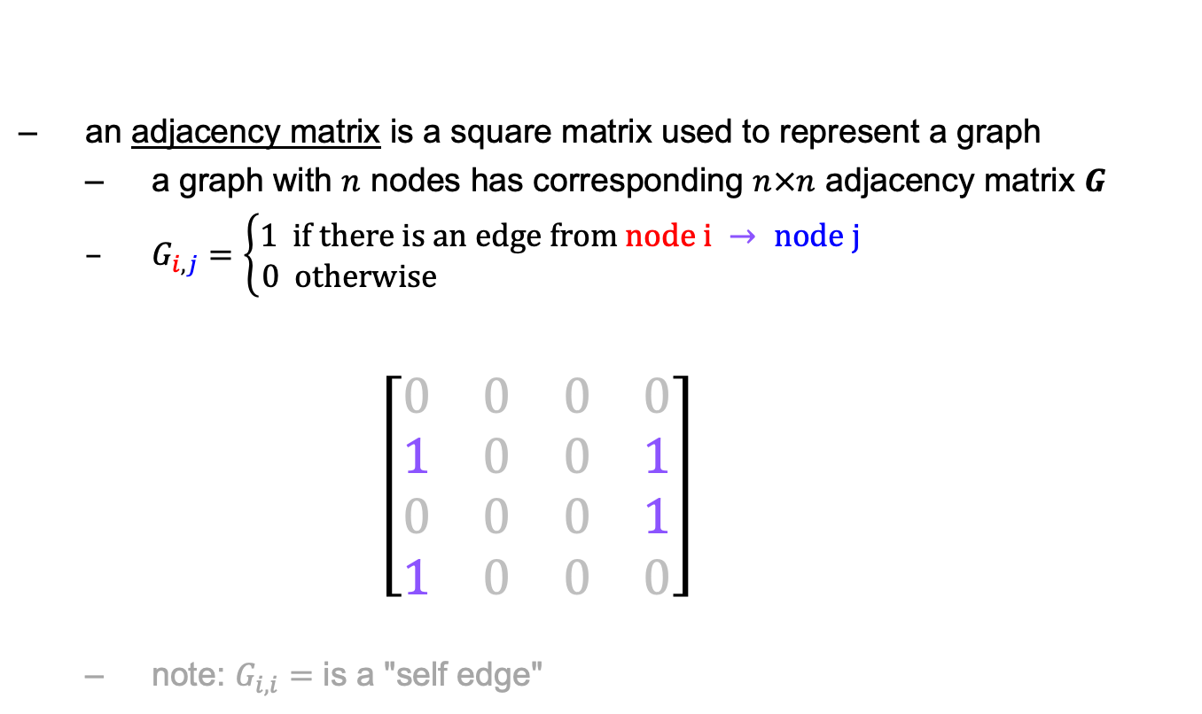
math: adjacency matrix
an adjacency matrix is a square matrix used to represent a graph
a graph with $n$ nodes has corresponding $n×n$ adjacency matrix $G$
$G_{i,j}=\left\{\begin{aligned}1 if there is an edge from node i → node j \\ 0 otherwise \end{aligned}\right.$ $\left[\begin{matrix}0 & 0 & 0 & 0 \\ 1 & 0 & 0 & 1 \\ 0 & 0 & 0 & 1 \\ 1 & 0 & 0 & 0\end{matrix}\right]$
note: $G_{i,i}=$ is a "self edge"
$$\begin{matrix}0 & 1 & 2 & 3\end{matrix}$$
0
1
$$\begin{matrix}0 \\ 1 \\ 2 \\ 3\end{matrix}$$
3
2

Slide 178
dense matrix at 2D array
int[][] graph = new int[4][4];
graph[1][0] = 1;
graph[1][3] = 1;
graph[2][3] = 1;
graph[3][0] = 1;
$$\begin{matrix}0 & 1 & 2 & 3\end{matrix}$$
0
1
$$\begin{matrix}0 \\ 1 \\ 2 \\ 3\end{matrix}$$
$$\left[\begin{matrix}0 & 0 & 0 & 0 \\ 1 & 0 & 0 & 1 \\ 0 & 0 & 0 & 1 \\ 1 & 0 & 0 & 0\end{matrix}\right]$$
3
2

Slide 179
dense matrix as 1D array
int[] graph = new int[4 * 4];
graph[4 * 1 + 0] = 1;
graph[4 * 1 + 3] = 1;
graph[4 * 2 + 3] = 1;
graph[4 * 3 + 0] = 1;
$$\begin{matrix}0 & 1 & 2 & 3\end{matrix}$$
0
1
$$\begin{matrix}0 \\ 1 \\ 2 \\ 3\end{matrix}$$
$$\left[\begin{matrix}0 & 0 & 0 & 0 \\ 1 & 0 & 0 & 1 \\ 0 & 0 & 0 & 1 \\ 1 & 0 & 0 & 0\end{matrix}\right]$$
3
2
$$\left[\begin{matrix}0 & 0 & 0 & 0 & 1 & 0 & 0 & 1 & 0 & 0 & 0 & 1 & 1 & 0 & 0 & 0\end{matrix}\right]$$
$$\begin{matrix}(0, 0) & (0, 1) & (0, 2) & (0, 3) & (1, 0) & (1, 1) & (1, 2) & (1, 3) & (2, 0) & (2, 1) & (2, 2) & (2, 3) & (3, 0) & (3, 1) & (3, 2) & (3, 3)\end{matrix}$$

Slide 180
sparse matrix
class Entry {
int row;
int col;
int val;
Entry(...) { ... }
}
ArrayList<Entry> graph = new ArrayList<>();
graph.add(new Entry(1, 0, 1));
graph.add(new Entry(1, 3, 1));
graph.add(new Entry(2, 3, 1));
graph.add(new Entry(3, 0, 1));
$$\begin{matrix}0 & 1 & 2 & 3\end{matrix}$$
0
1
$$\begin{matrix}0 \\ 1 \\ 2 \\ 3\end{matrix}$$
$$\left[\begin{matrix}0 & 0 & 0 & 0 \\ 1 & 0 & 0 & 1 \\ 0 & 0 & 0 & 1 \\ 1 & 0 & 0 & 0\end{matrix}\right]$$
3
2

Slide 181
Week11a
WARMUP
What does this print?
PRINT(0.1 + 0.2);
PRINT(SQRT(2.0) * SQRT(2.0));
the Fibonacci sequence
recursion
dynamic programming
🦜🦜🦜🦜🦜🦜🦜🦜🦜🦜🦜
🍉
WARMUP
What is F₇?
F₀ = 0
F₁ = 1
F_{k} = F_{k - 1} + F_{k - 2}

Slide 182
what are these?
🍉

Slide 183

the

Slide 184
👼

Slide 185
the Fibonacci sequence

Slide 186


Slide 187
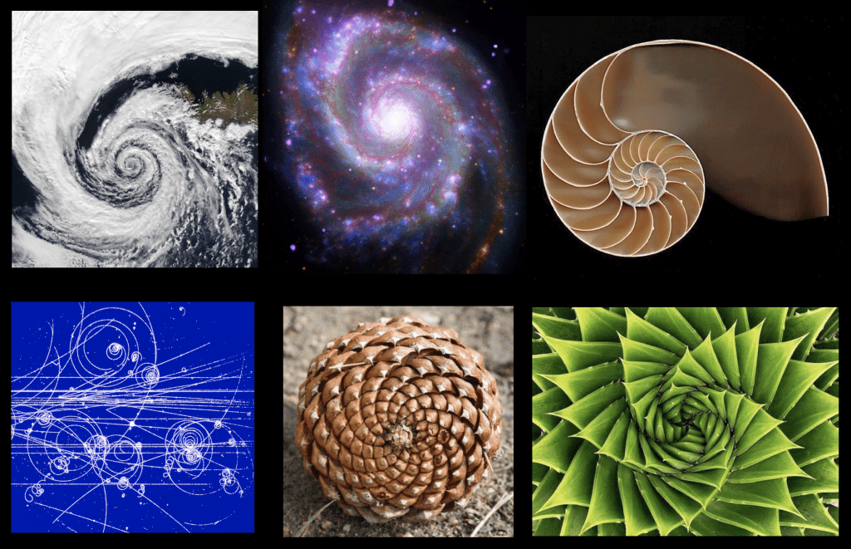

Slide 188
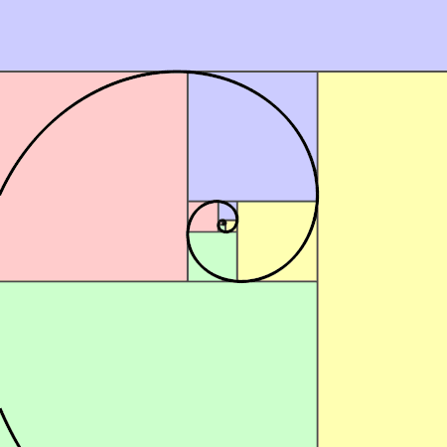

Slide 189
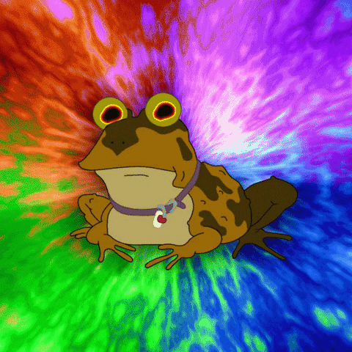

Slide 190
// F_0 = 0
// F_1 = 1
// F_2 = F_1 + F_0 = 1 + 0 = 1
// F_3 = F_2 + F_1 = 1 + 1 = 2
// F_4 = F_3 + F_2 = 2 + 1 = 3
// F_5 = F_4 + F_3 = 3 + 2 = 5
// F_6 = F_5 + F_4 = 5 + 3 = 8
// F_7 = F_6 + F_5 = 8 + 5 = 13
// ...

Slide 191
recursion

Slide 192
review: recursion basics

Slide 193
recursion
a recursive function is a function that calls itself
each call must make progress towards a base case (when the function finally returns without calling itself)
✨ when in doubt, try something like zero for your base case
class Main {
static int digitSum(int n) {
if (n == 0) {
return 0;
}
return digitSum(n / 10) + (n % 10);
}
public static void main(String[] arguments) {
PRINT(digitSum(256)); // 13
}
}

Slide 194
static int digitSum(int n) {
if (n == 0) {
return 0;
}
return digitSum(n / 10) + (n % 10);
}
return 0;
return digitSum(0) + 2;
return digitSum(2) + 5;
return digitSum(25) + 6;
int a = digitSum(256);

Slide 195
static int digitSum(int n) {
if (n == 0) {
return 0;
}
return digitSum(n / 10) + (n % 10);
}
return 0;
return digitSum(0) + 2;
return digitSum(2) + 5;
return digitSum(25) + 6;
int a = digitSum(256);

Slide 196
static int digitSum(int n) {
if (n == 0) {
return 0;
}
return digitSum(n / 10) + (n % 10);
}
return 0 + 2;
return digitSum(2) + 5;
return digitSum(25) + 6;
int a = digitSum(256);

Slide 197
static int digitSum(int n) {
if (n == 0) {
return 0;
}
return digitSum(n / 10) + (n % 10);
}
return 2;
return digitSum(2) + 5;
return digitSum(25) + 6;
int a = digitSum(256);

Slide 198
static int digitSum(int n) {
if (n == 0) {
return 0;
}
return digitSum(n / 10) + (n % 10);
}
return 2;
return digitSum(2) + 5;
return digitSum(25) + 6;
int a = digitSum(256);

Slide 199
static int digitSum(int n) {
if (n == 0) {
return 0;
}
return digitSum(n / 10) + (n % 10);
}
return 2 + 5;
return digitSum(25) + 6;
int a = digitSum(256);

Slide 200
static int digitSum(int n) {
if (n == 0) {
return 0;
}
return digitSum(n / 10) + (n % 10);
}
return 7;
return digitSum(25) + 6;
int a = digitSum(256);

Slide 201
static int digitSum(int n) {
if (n == 0) {
return 0;
}
return digitSum(n / 10) + (n % 10);
}
return 7;
return digitSum(25) + 6;
int a = digitSum(256);

Slide 202
static int digitSum(int n) {
if (n == 0) {
return 0;
}
return digitSum(n / 10) + (n % 10);
}
return 7 + 6;
int a = digitSum(256);

Slide 203
static int digitSum(int n) {
if (n == 0) {
return 0;
}
return digitSum(n / 10) + (n % 10);
}
return 13;
int a = digitSum(256);

Slide 204
static int digitSum(int n) {
if (n == 0) {
return 0;
}
return digitSum(n / 10) + (n % 10);
}
return 13;
int a = digitSum(256);

Slide 205
static int digitSum(int n) {
if (n == 0) {
return 0;
}
return digitSum(n / 10) + (n % 10);
}
int a = 13;

Slide 206
fin.

Slide 207
⚠️ recursion hazard 1 repeated computation

Slide 208
🐌 example: slow very slow fibonnaci (couldn't we just use a for loop...?)
// F_0 = 0
// F_1 = 1
// F_2 = F_1 + F_0 = 1 + 0 = 1
// F_3 = F_2 + F_1 = 1 + 1 = 2
// F_4 = F_3 + F_2 = 2 + 1 = 3
// F_5 = F_4 + F_3 = 3 + 2 = 5
// ...
static long fib(long k) {
if (k == 0) { return 0; }
if (k == 1) { return 1; }
return fib(k - 1) + fib(k - 2);
}

Slide 209
fib(4)

Slide 210
(fib(3) + fib(2))

Slide 211
((fib(2) + fib(1)) + (fib(1) + fib(0)))

Slide 212
(((fib(1) + fib(0)) + fib(1)) + (fib(1) + fib(0)))

Slide 213
(((1 + 0) + 1) + (1 + 0))

Slide 214
((1 + 1) + 1)

Slide 215
(2 + 1)

Slide 216
3

Slide 217
fib(4)

Slide 218
fib(4)
fib(3)
fib(2)

Slide 219
fib(4)
fib(3)
fib(2)
fib(2)
fib(1)

Slide 220
fib(4)
fib(3)
fib(2)
fib(2)
fib(1)
fib(1)
fib(0)

Slide 221
fib(4)
fib(3)
fib(2)
fib(2)
fib(1)
1
0

Slide 222
fib(4)
fib(3)
fib(2)
1
fib(1)

Slide 223
fib(4)
fib(3)
fib(2)
1
1

Slide 224
fib(4)
2
fib(2)

Slide 225
fib(4)
2
fib(2)
fib(1)
fib(0)

Slide 226
fib(4)
2
fib(2)
1
0

Slide 227
fib(4)
2
1

Slide 228
3

Slide 229
🙂

Slide 230
☹️

Slide 231
3

Slide 232
fib(4)

Slide 233
fib(4)
fib(3)
fib(2)
fib(2)
fib(1)
fib(1)
fib(0)
😱 what about this picture does NOT spark joy?
fib(1)
fib(0)

Slide 234
fib(4)
fib(3)
fib(2)
fib(2)
fib(1)
fib(1)
fib(0)
fib(1)
fib(0)

Slide 235
we computed fib(2) from scratch two seperate times 😱 we are repeating computation! (what a waste 😞)

Slide 236
and for bigger n... there is (much) more repetition

Slide 237
F₆
F₄
F₅
F₂
F₃
F₃
F₄
F₀
F₁
F₁
F₂
F₁
F₂
F₂
F₃
F₀
F₁
F₀
F₁
F₀
F₁
F₁
F₂
F₀
F₁

Slide 238
F₆
F₄
F₅
F₂
F₃
F₃
F₄
F₀
F₁
F₁
F₂
F₁
F₂
F₂
F₃
F₀
F₁
F₀
F₁
F₀
F₁
F₁
F₂
F₀
F₁
🧠 who's that
big O runtime?

Slide 239
exponential 🙀

Slide 240
[fib(5), fib(36), fib(77) demo]

Slide 241
⚠️ recursion hazard 2 stack overflow

Slide 242
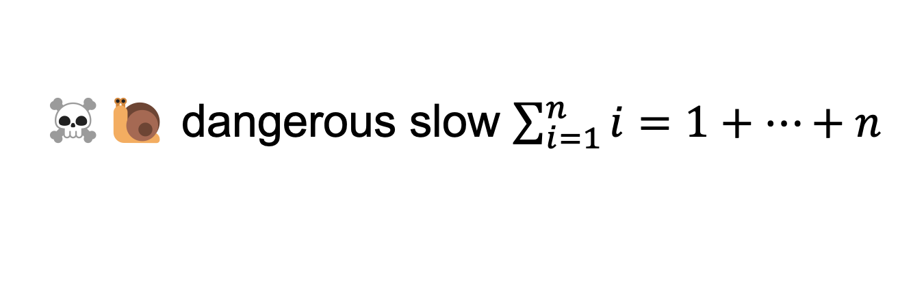
☠️🐌 dangerous slow $\sum_{i=1}^{n}{i}=1+…+n$
// 1 + ... + n
static int sum(int n) {
if (n == 0) return 0;
return n + sum(n - 1);
}

Slide 243
sum(100000)

Slide 244
sum(99999)
sum(100000)

Slide 245
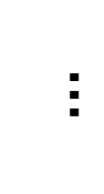
sum(0)
$$…$$
😱 what about this picture does NOT spark joy?
sum(99999)
sum(100000)

Slide 246
the height of the callstack is O(n) 😱 big n → stack overflow! 😞

Slide 247
[sum(100000) demo]

Slide 248
🧠 our depth-first binary (search) tree traversals were recursive... ...should we be worried about them overflowing the callstack?

Slide 249
no. (assuming your tree is ~balanced) callstack height for depth-first balanced binary tree traversal is log(n)
0
1
2
3
4 5
1 1 1 1 1 2 3
0 0 0 0 0 0 0 0 0 0 0
4
5
time

Slide 250
*additionally, some languages/compilers** have "tail-call optimization," which would prevent a stack overflow for sum(100000) **Java is not one of these languages (as our demo showed)

Slide 251
dynamic programming

Slide 252
dynamic programming is when you use the result of previous computation (this is a squishy definition)

Slide 253
F₆
F₄
F₅
F₂
F₃
F₃
F₄
F₀
F₁
F₁
F₂
F₁
F₂
F₂
F₃
F₀
F₁
F₀
F₁
F₀
F₁
F₁
F₂
F₀
F₁

Slide 254
F₆
F₅
F₄
F₄
F₃
F₃
F₂
F₂
F₁
F₁
F₀

Slide 255
F₆
F₅
F₄
F₄
F₃
F₃
F₂
F₂
F₁
F₁
F₀
🧠 who's that
big O runtime?

Slide 256
linear 🙂👍

Slide 257
memoization

Slide 258
memoization means storing the results of previous functions calls, so we don't have to repeat work when the function is called again

Slide 259
🙂 memoized fibonacci
static HashMap<Long, Long> table = new HashMap<>();
static long memoizedFib(long k) { // NOTE: long is an integer type
// that can store larger numbers than int
if (k == 0) { return 0; }
if (k == 1) { return 1; }
long Fkm1;
if (table.containsKey(k - 1)) {
Fkm1 = table.get(k - 1);
} else {
Fkm1 = memoizedFib(k - 1);
table.put(k - 1, Fkm1);
}
long Fkm2;
if (table.containsKey(k - 2)) {
Fkm2 = table.get(k - 2);
} else {
Fkm2 = memoizedFib(k - 2);
table.put(k - 2, Fkm2);
}
return Fkm1 + Fkm2;
}
🧠 what's the runtime of each call to memoizedFib(...)?
public static void main(...) {
int n = ...;
long a = memoizedFib(n);
long b = memoizedFib(n - 1);
long c = memoizedFib(n + 1);
}

Slide 260
int n = ...; long a = memoizedFib(n); // O(n) long b = memoizedFib(n - 1); // O(1) long c = memoizedFib(n + 1); // O(1)

Slide 261
👻 closed form fibonacci

Slide 262
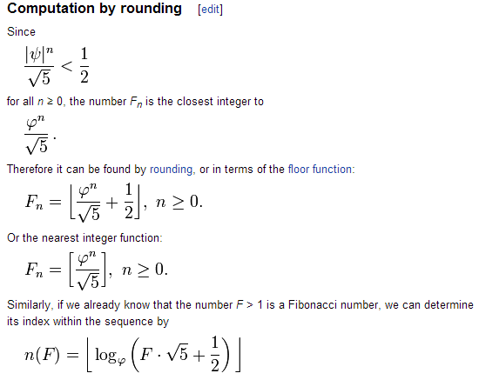

Slide 263
👻 approximate closed-form fibonnaci
// NOTE: Because of floating point error, this does not work for big n.
// (On my computer, returns wrong result for n > 70.)
static long closedFormFib(long n) {
final double goldenRatio = (1.0 + Math.sqrt(5.0)) / 2.0;
return Math.round(Math.pow(goldenRatio, n) / Math.sqrt(5.0));
}

Slide 264
exponentiation by squaring

Slide 265
note: there is actually a log(n) algorithm using matrices and "exponentiation by squaring" this algorithm does NOT have floating point problems (all numbers are integers)

Slide 266


Slide 267
Week11b
WARMUP
Say n = 64
Your goal is to compute 3^n ("3 to the n-th power") using only the multiplication operator (*)
Give an O(n) algorithm
Give an O(log n) algorithm
Fibonacci wrapup
recursion example
🦜🦜🦜🦜🦜🦜🦜🦜🦜🦜🦜

Slide 268
recursive fibonacci wrapup

Slide 269
review: bad bad very bad recursive O(2^n) fibonacci

Slide 270
🐌 recursive O(2^n) fibonacci
static long fib(long k) {
if (k == 0) { return 0; }
if (k == 1) { return 1; }
return fib(k - 1) + fib(k - 2);
}

Slide 271
review: recursive memoized O(n) fibonacci

Slide 272
🙂 memoized recursive O(n) fibonacci
// NOTE: Could also have used an array, with, for example, value 0 meaning "not yet computed."
static HashMap<Integer, Long> table = new HashMap<>();
static long fib(int k) {
if (k == 0) { return 0; }
if (k == 1) { return 1; }
long Fkm1;
if (table.containsKey(k - 1)) {
Fkm1 = table.get(k - 1);
} else {
Fkm1 = fib(k - 1);
table.put(k - 1, Fkm1);
}
long Fkm2;
if (table.containsKey(k - 2)) {
Fkm2 = table.get(k - 2);
} else {
Fkm2 = fib(k - 2);
table.put(k - 2, Fkm2);
}
return Fkm1 + Fkm2;
}

Slide 273
can we get the best of both worlds? (easy to read, fast)

Slide 274
[add a helper function]

Slide 275
🙂 recursive O(n) fibonnaci
static HashMap<Integer, Long> table = new HashMap<>();
static long fibHelper(int k) {
long result;
if (table.containsKey(k)) {
result = table.get(k);
} else {
result = fib(k);
table.put(k, result);
}
return result;
}
static long fib(int k) {
if (k == 0) { return 0; }
if (k == 1) { return 1; }
return fibHelper(k - 1) + fibHelper(k - 2);
}

Slide 276
alternate fibonacci approaches

Slide 277
iterative (not-recursive) O(n) fibonacci

Slide 278
🙂 iterative O(n) fibonnaci
(F₁, F₀) ← = (1, 0)
(F₂, F₁) ← (1 + 0, 1) = (1, 1)
(F₃, F₂) ← (1 + 1, 1) = (2, 1)
(F₄, F₃) ← (2 + 1, 2) = (3, 2)
(F₅, F₄) ← (3 + 2, 3) = (5, 3)
static long fib(int n) {
long F_i = 1;
long F_im1 = 0;
for (int i = 2; i <= n + 1; ++i) {
// (F_i, F_im1) <- (F_i + F_im1, F_i)
long tmp = F_i;
F_i += F_im1;
F_im1 = tmp;
}
return F_im1;
}
TODO make better
def fib(n):
F_i = 1
F_im1 = 0
for i in range(2, n + 2):
F_i, F_im1 = (F_i + F_im1), F_i
return F_im1

Slide 279
closed form fibonacci

Slide 281
👻 approximate closed-form fibonnaci
// NOTE: Because of floating point error, this does not work for big n.
// (On my computer, returns wrong result for n > 70.)
static long closedFormFib(long n) {
final double goldenRatio = (1.0 + Math.sqrt(5.0)) / 2.0;
return Math.round(Math.pow(goldenRatio, n) / Math.sqrt(5.0));
}

Slide 282
O(log n) matrix exponentiation by squaring (oh no) 😀

Slide 283
problem: calculate fib(64) observation: 64 = 2 * 2 * 2 * 2 * 2 * 2

Slide 284
[matrix multiplication review]

Slide 285
[update rule as a matrix multiplication]

Slide 286
[matrix exponentiation by squaring]

Slide 287
recursion example subset sum

Slide 288
problem overview

Slide 289
given a finite set of numbers $\{a,b,c,…\}$, is there any subset that sums to target $T$?

Slide 290
no. --Mark

Slide 291
examples
is there any subset of { 1, 3, 5 } that sums to 4?
yes; { 1, 3 }
is there any subset of { 1, 3, 5 } that sums to 9?
yes; { 1, 3, 5 }
is there any subset of { 1, 3, 5 } that sums to 0?
yes; {}
is there any subset of { 1, 3, 5 } that sums to 7?
no

Slide 292
solution method

Slide 293
given a finite set of numbers $\{a,b,c,…\}$, is there any subset that sums to target $T$?

Slide 294
given a finite set of numbers $\{a,b,c,…\}$, is there any subset that sums to target $T$?

Slide 295
any
for each subset...
if it sums to target...
return true; 🙂
return false;

Slide 296
🧠 why is this maybe not so easy? "hard" means "hard for a computer to solve quickly"
for each subset...
if it sums to target...
return true; 🙂
return false;

Slide 297
what are the subsets of $\{ 1, 2, 3, 4, 5, 6, 7, 8, 9 \}$?

Slide 298
∅ | {1} | {2} | {3} | {4} | {5} | {6} | {7} | {8} | {9} | {1, 2} | {1, 3} | {1, 4} | {1, 5} | {1, 6} | {1, 7} | {1, 8} | {1, 9} | {2, 3} | {2, 4} | {2, 5} | {2, 6} | {2, 7} | {2, 8} | {2, 9} | {3, 4} | {3, 5} | {3, 6} | {3, 7} | {3, 8} | {3, 9} | {4, 5} | {4, 6} | {4, 7} | {4, 8} | {4, 9} | {5, 6} | {5, 7} | {5, 8} | {5, 9} | {6, 7} | {6, 8} | {6, 9} | {7, 8} | {7, 9} | {8, 9} | {1, 2, 3} | {1, 2, 4} | {1, 2, 5} | {1, 2, 6} | {1, 2, 7} | {1, 2, 8} | {1, 2, 9} | {1, 3, 4} | {1, 3, 5} | {1, 3, 6} | {1, 3, 7} | {1, 3, 8} | {1, 3, 9} | {1, 4, 5} | {1, 4, 6} | {1, 4, 7} | {1, 4, 8} | {1, 4, 9} | {1, 5, 6} | {1, 5, 7} | {1, 5, 8} | {1, 5, 9} | {1, 6, 7} | {1, 6, 8} | {1, 6, 9} | {1, 7, 8} | {1, 7, 9} | {1, 8, 9} | {2, 3, 4} | {2, 3, 5} | {2, 3, 6} | {2, 3, 7} | {2, 3, 8} | {2, 3, 9} | {2, 4, 5} | {2, 4, 6} | {2, 4, 7} | {2, 4, 8} | {2, 4, 9} | {2, 5, 6} | {2, 5, 7} | {2, 5, 8} | {2, 5, 9} | {2, 6, 7} | {2, 6, 8} | {2, 6, 9} | {2, 7, 8} | {2, 7, 9} | {2, 8, 9} | {3, 4, 5} | {3, 4, 6} | {3, 4, 7} | {3, 4, 8} | {3, 4, 9} | {3, 5, 6} | {3, 5, 7} | {3, 5, 8} | {3, 5, 9} | {3, 6, 7} | {3, 6, 8} | {3, 6, 9} | {3, 7, 8} | {3, 7, 9} | {3, 8, 9} | {4, 5, 6} | {4, 5, 7} | {4, 5, 8} | {4, 5, 9} | {4, 6, 7} | {4, 6, 8} | {4, 6, 9} | {4, 7, 8} | {4, 7, 9} | {4, 8, 9} | {5, 6, 7} | {5, 6, 8} | {5, 6, 9} | {5, 7, 8} | {5, 7, 9} | {5, 8, 9} | {6, 7, 8} | {6, 7, 9} | {6, 8, 9} | {7, 8, 9} | {1, 2, 3, 4} | {1, 2, 3, 5} | {1, 2, 3, 6} | {1, 2, 3, 7} | {1, 2, 3, 8} | {1, 2, 3, 9} | {1, 2, 4, 5} | {1, 2, 4, 6} | {1, 2, 4, 7} | {1, 2, 4, 8} | {1, 2, 4, 9} | {1, 2, 5, 6} | {1, 2, 5, 7} | {1, 2, 5, 8} | {1, 2, 5, 9} | {1, 2, 6, 7} | {1, 2, 6, 8} | {1, 2, 6, 9} | {1, 2, 7, 8} | {1, 2, 7, 9} | {1, 2, 8, 9} | {1, 3, 4, 5} | {1, 3, 4, 6} | {1, 3, 4, 7} | {1, 3, 4, 8} | {1, 3, 4, 9} | {1, 3, 5, 6} | {1, 3, 5, 7} | {1, 3, 5, 8} | {1, 3, 5, 9} | {1, 3, 6, 7} | {1, 3, 6, 8} | {1, 3, 6, 9} | {1, 3, 7, 8} | {1, 3, 7, 9} | {1, 3, 8, 9} | {1, 4, 5, 6} | {1, 4, 5, 7} | {1, 4, 5, 8} | {1, 4, 5, 9} | {1, 4, 6, 7} | {1, 4, 6, 8} | {1, 4, 6, 9} | {1, 4, 7, 8} | {1, 4, 7, 9} | {1, 4, 8, 9} | {1, 5, 6, 7} | {1, 5, 6, 8} | {1, 5, 6, 9} | {1, 5, 7, 8} | {1, 5, 7, 9} | {1, 5, 8, 9} | {1, 6, 7, 8} | {1, 6, 7, 9} | {1, 6, 8, 9} | {1, 7, 8, 9} | {2, 3, 4, 5} | {2, 3, 4, 6} | {2, 3, 4, 7} | {2, 3, 4, 8} | {2, 3, 4, 9} | {2, 3, 5, 6} | {2, 3, 5, 7} | {2, 3, 5, 8} | {2, 3, 5, 9} | {2, 3, 6, 7} | {2, 3, 6, 8} | {2, 3, 6, 9} | {2, 3, 7, 8} | {2, 3, 7, 9} | {2, 3, 8, 9} | {2, 4, 5, 6} | {2, 4, 5, 7} | {2, 4, 5, 8} | {2, 4, 5, 9} | {2, 4, 6, 7} | {2, 4, 6, 8} | {2, 4, 6, 9} | {2, 4, 7, 8} | {2, 4, 7, 9} | {2, 4, 8, 9} | {2, 5, 6, 7} | {2, 5, 6, 8} | {2, 5, 6, 9} | {2, 5, 7, 8} | {2, 5, 7, 9} | {2, 5, 8, 9} | {2, 6, 7, 8} | {2, 6, 7, 9} | {2, 6, 8, 9} | {2, 7, 8, 9} | {3, 4, 5, 6} | {3, 4, 5, 7} | {3, 4, 5, 8} | {3, 4, 5, 9} | {3, 4, 6, 7} | {3, 4, 6, 8} | {3, 4, 6, 9} | {3, 4, 7, 8} | {3, 4, 7, 9} | {3, 4, 8, 9} | {3, 5, 6, 7} | {3, 5, 6, 8} | {3, 5, 6, 9} | {3, 5, 7, 8} | {3, 5, 7, 9} | {3, 5, 8, 9} | {3, 6, 7, 8} | {3, 6, 7, 9} | {3, 6, 8, 9} | {3, 7, 8, 9} | {4, 5, 6, 7} | {4, 5, 6, 8} | {4, 5, 6, 9} | {4, 5, 7, 8} | {4, 5, 7, 9} | {4, 5, 8, 9} | {4, 6, 7, 8} | {4, 6, 7, 9} | {4, 6, 8, 9} | {4, 7, 8, 9} | {5, 6, 7, 8} | {5, 6, 7, 9} | {5, 6, 8, 9} | {5, 7, 8, 9} | {6, 7, 8, 9} | {1, 2, 3, 4, 5} | {1, 2, 3, 4, 6} | {1, 2, 3, 4, 7} | {1, 2, 3, 4, 8} | {1, 2, 3, 4, 9} | {1, 2, 3, 5, 6} | {1, 2, 3, 5, 7} | {1, 2, 3, 5, 8} | {1, 2, 3, 5, 9} | {1, 2, 3, 6, 7} | {1, 2, 3, 6, 8} | {1, 2, 3, 6, 9} | {1, 2, 3, 7, 8} | {1, 2, 3, 7, 9} | {1, 2, 3, 8, 9} | {1, 2, 4, 5, 6} | {1, 2, 4, 5, 7} | {1, 2, 4, 5, 8} | {1, 2, 4, 5, 9} | {1, 2, 4, 6, 7} | {1, 2, 4, 6, 8} | {1, 2, 4, 6, 9} | {1, 2, 4, 7, 8} | {1, 2, 4, 7, 9} | {1, 2, 4, 8, 9} | {1, 2, 5, 6, 7} | {1, 2, 5, 6, 8} | {1, 2, 5, 6, 9} | {1, 2, 5, 7, 8} | {1, 2, 5, 7, 9} | {1, 2, 5, 8, 9} | {1, 2, 6, 7, 8} | {1, 2, 6, 7, 9} | {1, 2, 6, 8, 9} | {1, 2, 7, 8, 9} | {1, 3, 4, 5, 6} | {1, 3, 4, 5, 7} | {1, 3, 4, 5, 8} | {1, 3, 4, 5, 9} | {1, 3, 4, 6, 7} | {1, 3, 4, 6, 8} | {1, 3, 4, 6, 9} | {1, 3, 4, 7, 8} | {1, 3, 4, 7, 9} | {1, 3, 4, 8, 9} | {1, 3, 5, 6, 7} | {1, 3, 5, 6, 8} | {1, 3, 5, 6, 9} | {1, 3, 5, 7, 8} | {1, 3, 5, 7, 9} | {1, 3, 5, 8, 9} | {1, 3, 6, 7, 8} | {1, 3, 6, 7, 9} | {1, 3, 6, 8, 9} | {1, 3, 7, 8, 9} | {1, 4, 5, 6, 7} | {1, 4, 5, 6, 8} | {1, 4, 5, 6, 9} | {1, 4, 5, 7, 8} | {1, 4, 5, 7, 9} | {1, 4, 5, 8, 9} | {1, 4, 6, 7, 8} | {1, 4, 6, 7, 9} | {1, 4, 6, 8, 9} | {1, 4, 7, 8, 9} | {1, 5, 6, 7, 8} | {1, 5, 6, 7, 9} | {1, 5, 6, 8, 9} | {1, 5, 7, 8, 9} | {1, 6, 7, 8, 9} | {2, 3, 4, 5, 6} | {2, 3, 4, 5, 7} | {2, 3, 4, 5, 8} | {2, 3, 4, 5, 9} | {2, 3, 4, 6, 7} | {2, 3, 4, 6, 8} | {2, 3, 4, 6, 9} | {2, 3, 4, 7, 8} | {2, 3, 4, 7, 9} | {2, 3, 4, 8, 9} | {2, 3, 5, 6, 7} | {2, 3, 5, 6, 8} | {2, 3, 5, 6, 9} | {2, 3, 5, 7, 8} | {2, 3, 5, 7, 9} | {2, 3, 5, 8, 9} | {2, 3, 6, 7, 8} | {2, 3, 6, 7, 9} | {2, 3, 6, 8, 9} | {2, 3, 7, 8, 9} | {2, 4, 5, 6, 7} | {2, 4, 5, 6, 8} | {2, 4, 5, 6, 9} | {2, 4, 5, 7, 8} | {2, 4, 5, 7, 9} | {2, 4, 5, 8, 9} | {2, 4, 6, 7, 8} | {2, 4, 6, 7, 9} | {2, 4, 6, 8, 9} | {2, 4, 7, 8, 9} | {2, 5, 6, 7, 8} | {2, 5, 6, 7, 9} | {2, 5, 6, 8, 9} | {2, 5, 7, 8, 9} | {2, 6, 7, 8, 9} | {3, 4, 5, 6, 7} | {3, 4, 5, 6, 8} | {3, 4, 5, 6, 9} | {3, 4, 5, 7, 8} | {3, 4, 5, 7, 9} | {3, 4, 5, 8, 9} | {3, 4, 6, 7, 8} | {3, 4, 6, 7, 9} | {3, 4, 6, 8, 9} | {3, 4, 7, 8, 9} | {3, 5, 6, 7, 8} | {3, 5, 6, 7, 9} | {3, 5, 6, 8, 9} | {3, 5, 7, 8, 9} | {3, 6, 7, 8, 9} | {4, 5, 6, 7, 8} | {4, 5, 6, 7, 9} | {4, 5, 6, 8, 9} | {4, 5, 7, 8, 9} | {4, 6, 7, 8, 9} | {5, 6, 7, 8, 9} | {1, 2, 3, 4, 5, 6} | {1, 2, 3, 4, 5, 7} | {1, 2, 3, 4, 5, 8} | {1, 2, 3, 4, 5, 9} | {1, 2, 3, 4, 6, 7} | {1, 2, 3, 4, 6, 8} | {1, 2, 3, 4, 6, 9} | {1, 2, 3, 4, 7, 8} | {1, 2, 3, 4, 7, 9} | {1, 2, 3, 4, 8, 9} | {1, 2, 3, 5, 6, 7} | {1, 2, 3, 5, 6, 8} | {1, 2, 3, 5, 6, 9} | {1, 2, 3, 5, 7, 8} | {1, 2, 3, 5, 7, 9} | {1, 2, 3, 5, 8, 9} | {1, 2, 3, 6, 7, 8} | {1, 2, 3, 6, 7, 9} | {1, 2, 3, 6, 8, 9} | {1, 2, 3, 7, 8, 9} | {1, 2, 4, 5, 6, 7} | {1, 2, 4, 5, 6, 8} | {1, 2, 4, 5, 6, 9} | {1, 2, 4, 5, 7, 8} | {1, 2, 4, 5, 7, 9} | {1, 2, 4, 5, 8, 9} | {1, 2, 4, 6, 7, 8} | {1, 2, 4, 6, 7, 9} | {1, 2, 4, 6, 8, 9} | {1, 2, 4, 7, 8, 9} | {1, 2, 5, 6, 7, 8} | {1, 2, 5, 6, 7, 9} | {1, 2, 5, 6, 8, 9} | {1, 2, 5, 7, 8, 9} | {1, 2, 6, 7, 8, 9} | {1, 3, 4, 5, 6, 7} | {1, 3, 4, 5, 6, 8} | {1, 3, 4, 5, 6, 9} | {1, 3, 4, 5, 7, 8} | {1, 3, 4, 5, 7, 9} | {1, 3, 4, 5, 8, 9} | {1, 3, 4, 6, 7, 8} | {1, 3, 4, 6, 7, 9} | {1, 3, 4, 6, 8, 9} | {1, 3, 4, 7, 8, 9} | {1, 3, 5, 6, 7, 8} | {1, 3, 5, 6, 7, 9} | {1, 3, 5, 6, 8, 9} | {1, 3, 5, 7, 8, 9} | {1, 3, 6, 7, 8, 9} | {1, 4, 5, 6, 7, 8} | {1, 4, 5, 6, 7, 9} | {1, 4, 5, 6, 8, 9} | {1, 4, 5, 7, 8, 9} | {1, 4, 6, 7, 8, 9} | {1, 5, 6, 7, 8, 9} | {2, 3, 4, 5, 6, 7} | {2, 3, 4, 5, 6, 8} | {2, 3, 4, 5, 6, 9} | {2, 3, 4, 5, 7, 8} | {2, 3, 4, 5, 7, 9} | {2, 3, 4, 5, 8, 9} | {2, 3, 4, 6, 7, 8} | {2, 3, 4, 6, 7, 9} | {2, 3, 4, 6, 8, 9} | {2, 3, 4, 7, 8, 9} | {2, 3, 5, 6, 7, 8} | {2, 3, 5, 6, 7, 9} | {2, 3, 5, 6, 8, 9} | {2, 3, 5, 7, 8, 9} | {2, 3, 6, 7, 8, 9} | {2, 4, 5, 6, 7, 8} | {2, 4, 5, 6, 7, 9} | {2, 4, 5, 6, 8, 9} | {2, 4, 5, 7, 8, 9} | {2, 4, 6, 7, 8, 9} | {2, 5, 6, 7, 8, 9} | {3, 4, 5, 6, 7, 8} | {3, 4, 5, 6, 7, 9} | {3, 4, 5, 6, 8, 9} | {3, 4, 5, 7, 8, 9} | {3, 4, 6, 7, 8, 9} | {3, 5, 6, 7, 8, 9} | {4, 5, 6, 7, 8, 9} | {1, 2, 3, 4, 5, 6, 7} | {1, 2, 3, 4, 5, 6, 8} | {1, 2, 3, 4, 5, 6, 9} | {1, 2, 3, 4, 5, 7, 8} | {1, 2, 3, 4, 5, 7, 9} | {1, 2, 3, 4, 5, 8, 9} | {1, 2, 3, 4, 6, 7, 8} | {1, 2, 3, 4, 6, 7, 9} | {1, 2, 3, 4, 6, 8, 9} | {1, 2, 3, 4, 7, 8, 9} | {1, 2, 3, 5, 6, 7, 8} | {1, 2, 3, 5, 6, 7, 9} | {1, 2, 3, 5, 6, 8, 9} | {1, 2, 3, 5, 7, 8, 9} | {1, 2, 3, 6, 7, 8, 9} | {1, 2, 4, 5, 6, 7, 8} | {1, 2, 4, 5, 6, 7, 9} | {1, 2, 4, 5, 6, 8, 9} | {1, 2, 4, 5, 7, 8, 9} | {1, 2, 4, 6, 7, 8, 9} | {1, 2, 5, 6, 7, 8, 9} | {1, 3, 4, 5, 6, 7, 8} | {1, 3, 4, 5, 6, 7, 9} | {1, 3, 4, 5, 6, 8, 9} | {1, 3, 4, 5, 7, 8, 9} | {1, 3, 4, 6, 7, 8, 9} | {1, 3, 5, 6, 7, 8, 9} | {1, 4, 5, 6, 7, 8, 9} | {2, 3, 4, 5, 6, 7, 8} | {2, 3, 4, 5, 6, 7, 9} | {2, 3, 4, 5, 6, 8, 9} | {2, 3, 4, 5, 7, 8, 9} | {2, 3, 4, 6, 7, 8, 9} | {2, 3, 5, 6, 7, 8, 9} | {2, 4, 5, 6, 7, 8, 9} | {3, 4, 5, 6, 7, 8, 9} | {1, 2, 3, 4, 5, 6, 7, 8} | {1, 2, 3, 4, 5, 6, 7, 9} | {1, 2, 3, 4, 5, 6, 8, 9} | {1, 2, 3, 4, 5, 7, 8, 9} | {1, 2, 3, 4, 6, 7, 8, 9} | {1, 2, 3, 5, 6, 7, 8, 9} | {1, 2, 4, 5, 6, 7, 8, 9} | {1, 3, 4, 5, 6, 7, 8, 9} | {2, 3, 4, 5, 6, 7, 8, 9} | {1, 2, 3, 4, 5, 6, 7, 8, 9}

Slide 299
there are $2^{9}$ of them

Slide 300
🧠 why?

Slide 301
each of the 9 elements is either included or not included (excluded) in the subset 9 include/exclude decisions => 2⁹

Slide 302

enumerate

Slide 303
what are the subsets of $\{3, 4, 5\}$?

Slide 304
what are the subsets of $\{3, 4, 5\}$?
all possible subsets
include 5?
$$\{\}$$
$$\{5\}$$
$$\{4\}$$
$$\{4,5\}$$
$$\{3\}$$
$$\{3,5\}$$
$$\{3,4\}$$
$$\{3,4,5\}$$
include 4?
$$\{\}$$
$$\{4\}$$
$$\{3\}$$
$$\{3,4\}$$
no
yes
no
yes
include 3?
$$\{\}$$
$$\{3\}$$
no
yes
$$\{\}$$

Slide 305
hint

Slide 306
Question: “can any subset of $\left\{a,b,c,…\right\}$ sum to $T$?” key insight Considering just $a$, we have two cases: 1) exclude $a$ in this case, Equivalent Question: “can any subset of $\{b,c,…\}$ sum to $T$?” 2) include $a$ in this case, Equivalent Question: “can any subset of $\{b,c,…\}$ sum to $T−a$?”

Slide 307
does any subset of {} sum to 0?
include 2nd
element?
$$\{\}$$
$$\{5\}$$
$$\{4\}$$
$$\{4,5\}$$
$$\{3\}$$
$$\{3,5\}$$
$$\{3,4\}$$
$$\{3,4,5\}$$
$$\{\}$$
$$\{4\}$$
$$\{3\}$$
$$\{3,4\}$$
include 1st
element?
$$\{\}$$
does any subset of $\left\{5\right\}$ sum to 5?
$$\{3\}$$
include 0th
element?
does any subset of $\left\{4,5\right\}$ sum to 5?
$$\{\}$$
does any subset of $\left\{3,4,5\right\}$ sum to 8?

Slide 308
okay cool good luck

Slide 309



Week11c
Final Project
WARMUP: What part of this game would you implement... first? last?

Slide 310
final project

Slide 311
final project

Slide 312
You may do your final project on whatever you like, provided you can answer the following questions.
What is the title of my project?
What data structures will I use? Note: Arrays count.
What is the game/app that I am proposing? What does it do? How does it feel?
Will the viewer/player interact with my project? How so?
Does Jim think my project is doable? What is my fallback plan if my project ends up being harder than I expect? What extensions can I do if my project ends up being easier than I expect?
What is the very first thing I will implement? (Drawing "the data" is usually a good first step.)

Slide 313
You may do your final project on whatever you like, provided you can answer the following questions.
What is the title of my project?
What data structures will I use? Note: Arrays count.
What is the game/app that I am proposing? What does it do? How does it feel?
Will the viewer/player interact with my project? How so?
Does Jim think my project is doable? What is my fallback plan if my project ends up being harder than I expect? What extensions can I do if my project ends up being easier than I expect?
What is the very first thing I will implement? (Drawing "the data" is usually a good first step.)

Slide 314
example
Woo!-doku
2D array to represent the board.
A colorful sudoku board, that does a happy dance when you solve it.
Click to select cells. Type numbers on the keyboard to fill in numbers.
Yes! And you can write a sudoku solver or automatic board generation if you have extra time!
Store a board I found on the internet as a 2D array (0's for empty cells) and draw it to the Terminal using print statements (or...just skip straight to Cow)

Slide 315
how are we feeling?

Slide 316
why am i making you make a thing

Slide 317


The only way you’re going to grow is by pushing yourself beyond what you think is possible. --David Goggins

Slide 318
how not to make a thing

Slide 319
how not to make a thing

Slide 320
note: this advice is like...just advice feel free to ignore (at your own peril) 🙂

Slide 321
project selection

Slide 322


⚠ picking something really, really hard

Slide 323
⚠ picking something with a spooky progress curve
does it work?
deadline
time

Slide 324

⚠ picking something you aren't really interested in (or can't really be extended)
note: though if you love calculators, go for it!

Slide 325


Slide 327
who (doesn't) have a final project idea? discuss amongst each other

Slide 328
focus (just make sudoku)

Slide 329


⚠ solving a more general problem than you need to
don't support arbitrary board sizes!
just make sudoku!
what?!

Slide 330

⚠ writing more general code than you need to
don't support multiple different kinds of puzzles
just make sudoku!

Slide 331

⚠ doing the fun part first
don't make a fun animated menu screen
just make sudoku!

Slide 332

⚠ skipping development steps
consider making a board print to the terminal
before trying to get it working in Cow.java
consider just filling it with nonsense before filling it with a real board
consider hardcoding a starting board by hand
before implementing automatic board generation

Slide 333

then again, sometimes you just gotta go for it.

Slide 334
who (doesn't) know what they're going to implement first? discuss amongst each other

Slide 335
final thoughts

Slide 336
final thoughts
don't be afraid to write code
don't be afraid to delete code
don't be (too) afraid to fail
you will be graded primarily on effort

Slide 337
how are we feeling?

Slide 338
WARMUP
what is (0.1 + 0.1 + 0.1) ?
imagine you wanted to make this thing →
what would you implement 1st? 2nd?
what would you implement LAST? TODAY
who's to say
Bubble Bobble (NES)

Slide 339
Week10a
✨No Laptop Monday! ✨
binary search
binary search trees
WARMUP
how long does it take to find (search for) something in...
- an array list?
- a linked list?
what if the list is sorted?

Slide 340
[record lecture]

Slide 341
review: sorted

Slide 342
sorted

Slide 343
sorted
a sequence is sorted if its elements are "in order"
by convention, this means ascending order (going up from left to right)
[1, 2, 5, 6, 9, 13] is sorted
[9, 5, 1, 2, 6, 13] is unsorted (NOT sored)

Slide 344
search

Slide 345
search
to search means to look for something (in some data structure)
a simple search problem is finding a given value in an array / list
// get index of the first element in array with this value // returns -1 if value not found int find(int[] array, int value) { ... }
// Option B class FindResult { boolean success; int index; } FindResult find(int[] array, int value) { ... }

Slide 346
linear search (of an array / array list)

Slide 347
linear search (brute force search)
linear search looks at each element one by one
linear search works whether or not the list is sorted
linear search is O(n) (linear time) 😐
// get index of the first element in array with this value // returns -1 if value not found int linearSearch(int[] array, int value) { for (int i = 0; i < array.length; ++i) { if (array[i] == value) { return i; } } return -1; }

Slide 348
example: linear search for 17 [13 2 55 7 17 100 77]

Slide 349
example: linear search for 17 [13 2 55 7 17 100 77]

Slide 350
example: linear search for 17 [13 2 55 7 17 100 77]

Slide 351
example: linear search for 17 [13 2 55 7 17 100 77]

Slide 352
example: linear search for 17 [13 2 55 7 17 100 77]

Slide 353
example: linear search for 17 [13 2 55 7 17 100 77]

Slide 354
example: linear search for 17 [13 2 55 7 17 100 77]

Slide 355
example: linear search for 17 [13 2 55 7 17 100 77]

Slide 356
example: linear search for 17 [13 2 55 7 17 100 77]

Slide 357
example: linear search for 17 [13 2 55 7 17 100 77]

Slide 358
example: linear search for 17 [13 2 55 7 17 100 77]

Slide 360
example: linear search for 17 [1 2 4 5 6 8 9 10 11 13 15 16 17 18 19]

Slide 361
example: linear search for 17 [1 2 4 5 6 8 9 10 11 13 15 16 17 18 19]

Slide 362
example: linear search for 17 [1 2 4 5 6 8 9 10 11 13 15 16 17 18 19]

Slide 363
example: linear search for 17 [1 2 4 5 6 8 9 10 11 13 15 16 17 18 19]

Slide 364
example: linear search for 17 [1 2 4 5 6 8 9 10 11 13 15 16 17 18 19]

Slide 365
example: linear search for 17 [1 2 4 5 6 8 9 10 11 13 15 16 17 18 19]

Slide 366
example: linear search for 17 [1 2 4 5 6 8 9 10 11 13 15 16 17 18 19]

Slide 367
example: linear search for 17 [1 2 4 5 6 8 9 10 11 13 15 16 17 18 19]

Slide 368
example: linear search for 17 [1 2 4 5 6 8 9 10 11 13 15 16 17 18 19]

Slide 369
example: linear search for 17 [1 2 4 5 6 8 9 10 11 13 15 16 17 18 19]

Slide 370
example: linear search for 17 [1 2 4 5 6 8 9 10 11 13 15 16 17 18 19]

Slide 371
example: linear search for 17 [1 2 4 5 6 8 9 10 11 13 15 16 17 18 19]

Slide 372
example: linear search for 17 [1 2 4 5 6 8 9 10 11 13 15 16 17 18 19]

Slide 373
example: linear search for 17 [1 2 4 5 6 8 9 10 11 13 15 16 17 18 19]

Slide 374
example: linear search for 17 [1 2 4 5 6 8 9 10 11 13 15 16 17 18 19]

Slide 375
example: linear search for 17 [1 2 4 5 6 8 9 10 11 13 15 16 17 18 19]

Slide 376
example: linear search for 17 [1 2 4 5 6 8 9 10 11 13 15 16 17 18 19]

Slide 377
example: linear search for 17 [1 2 4 5 6 8 9 10 11 13 15 16 17 18 19]

Slide 378
example: linear search for 17 [1 2 4 5 6 8 9 10 11 13 15 16 17 18 19]

Slide 379
example: linear search for 17 [1 2 4 5 6 8 9 10 11 13 15 16 17 18 19]

Slide 380
example: linear search for 17 [1 2 4 5 6 8 9 10 11 13 15 16 17 18 19]

Slide 381
example: linear search for 17 [1 2 4 5 6 8 9 10 11 13 15 16 17 18 19]

Slide 382
example: linear search for 17 [1 2 4 5 6 8 9 10 11 13 15 16 17 18 19]

Slide 383
example: linear search for 17 [1 2 4 5 6 8 9 10 11 13 15 16 17 18 19]

Slide 384
example: linear search for 17 [1 2 4 5 6 8 9 10 11 13 15 16 17 18 19]

Slide 385
example: linear search for 17 [1 2 4 5 6 8 9 10 11 13 15 16 17 18 19]

Slide 386
example: linear search for 17 [1 2 4 5 6 8 9 10 11 13 15 16 17 18 19]

Slide 387
if we know that an array is sorted... can we search it faster?

Slide 388
yes 🚀

Slide 389
unless it's a linked list 💀

Slide 390
binary search (of a array / array list)

Slide 391
binary search
binary search is an O(log n) algorithm for searching a sorted array 🙂
binary search works by "cutting the array in half" over and over
☠️ binary search only applies if the array is sorted

Slide 392
example: binary search for 17 [1 2 4 5 6 8 9 10 11 13 15 16 17 18 19]

Slide 393
example: binary search for 17 [1 2 4 5 6 8 9 10 11 13 15 16 17 18 19]
10 < 17

Slide 394
example: binary search for 17 [1 2 4 5 6 8 9 10 11 13 15 16 17 18 19]

Slide 395
example: binary search for 17 [1 2 4 5 6 8 9 10 11 13 15 16 17 18 19]
16 < 17

Slide 396
example: binary search for 17 [1 2 4 5 6 8 9 10 11 13 15 16 17 18 19]

Slide 397
example: binary search for 17 [1 2 4 5 6 8 9 10 11 13 15 16 17 18 19]
17 < 18

Slide 398
example: binary search for 17 [1 2 4 5 6 8 9 10 11 13 15 16 17 18 19]

Slide 399
example: binary search for 17 [1 2 4 5 6 8 9 10 11 13 15 16 17 18 19]
17 == 17

Slide 400
example: binary search for 17 [1 2 4 5 6 8 9 10 11 13 15 16 17 18 19]

Slide 401
☠️ implementating binary search is surprisingly tricky! make sure you test thoroughly!

Slide 402
✨ hint: binary search [1 2 4 5 6 8 9 10 11 13 15 16 17 18 19]
[^ 2 4 5 6 8 9 10 11 13 15 16 17 18 ^ ]
[| 2 4 5 6 8 9 10 11 13 15 16 17 18 | ]
[i = 0 4 5 6 8 9 10 11 13 15 16 17 18 j ]

Slide 403
review: binary tree

Slide 404
binary tree

Slide 405
binary tree
a binary tree is a tree in which each node has <= 2 children
10
5
16
2
13
18
1
4
11
15
17

Slide 406
🧠 can a linked list be seen as a binary tree?

Slide 407
technically, yes (assuming no cycles) all nodes have <= 2 children (tail has 0 children, all other nodes have 1 child)

Slide 408
ordered binary tree

Slide 409
(ordered) binary tree
each node has a left child and a right child (either or both children can be null)
10
5
16
node
13
18
11
15
17
node.leftChild
node.rightChild

Slide 410
(ordered) binary tree
each node has a left subtree and a right subtree (and left descendants and right descendants)

Slide 411
binary search tree

Slide 412
binary search tree

Slide 413
binary search tree
in a binary search tree (BST, sorted binary tree) every node follows: "a node's value is greater than the values of all nodes in its left subtree and less than the values of all nodes in its right subtree"
10
5
16
2
13
18
1
4
11
15
17

Slide 414
binary search tree
in a binary search tree (BST, sorted binary tree) every node follows: "a node's value is greater than the values of all nodes in its left subtree and less than the values of all nodes in its right subtree"
10
10 < 16
5
16
5 < 10
2 < 10
10 < 13
2
13
18
10 < 18
1
4
10 < 11
11
15
17
10 < 17
4 < 10
1 < 10
10 < 15

Slide 415
binary search tree
in a binary search tree (BST, sorted binary tree) every node follows: "a node's value is greater than the values of all nodes in its left subtree and less than the values of all nodes in its right subtree"
10
5
16
13 < 16
2
13
18
16 < 18
1
4
11 < 16
11
15
17
16 < 17
15 < 16

Slide 416
binary search tree
in a binary search tree (BST, sorted binary tree) every node follows: "a node's value is greater than the values of all nodes in its left subtree and less than the values of all nodes in its right subtree"
10
5
16
2
13
18
1
4
11
15
17

Slide 417
is it a BST?

Slide 418
2
4
1
3
6
Is It A Binary Search Tree?
4
9
3
5
in a binary search tree (sorted binary tree) every node follows: "a node's value is greater than the values of all nodes in its left subtree and less than the values of all nodes in its right subtree"
2
1
10
5
16
2
8
13
18
1
4
6
9
14
15
17
19

Slide 419
2
4
1
3
6
4
9
3
5
in a binary search tree (sorted binary tree) every node follows: "a node's value is greater than the values of all nodes in its left subtree and less than the values of all nodes in its right subtree"
2
1
10
5
16
2
8
13
18
1
4
6
9
14
15
17
19

Slide 420
binary search (of a binary search tree)

Slide 421
binary search
binary search "cuts a BST in half" over and over
binary search only works when the binary tree is sorted (is a binary search tree)
binary search is O(log n) if the tree is "balanced" 🙂
balanced means each node's children are similar in height (intuitive understanding of this is sufficient; will discuss more on Fri)
10
10
5
16
5
2
8
13
18
2
1
6
9
11
9
1
balanced
NOT balanced

Slide 422
example: binary search for 17 [1 2 4 5 6 8 9 10 11 13 15 16 17 18 19]
10
5
16
2
8
13
18
1
4
6
9
11
15
17
19

Slide 423
example: binary search for 17 [1 2 4 5 6 8 9 10 11 13 15 16 17 18 19]
10
10 < 17
5
16
2
8
13
18
1
4
6
9
11
15
17
19

Slide 424
example: binary search for 17 [1 2 4 5 6 8 9 10 11 13 15 16 17 18 19]
10
5
16
2
8
13
18
1
4
6
9
11
15
17
19

Slide 425
example: binary search for 17 [1 2 4 5 6 8 9 10 11 13 15 16 17 18 19]
10
5
16
16 < 17
2
8
13
18
1
4
6
9
11
15
17
19

Slide 426
example: binary search for 17 [1 2 4 5 6 8 9 10 11 13 15 16 17 18 19]
10
5
16
2
8
13
18
1
4
6
9
11
15
17
19

Slide 427
example: binary search for 17 [1 2 4 5 6 8 9 10 11 13 15 16 17 18 19]
10
5
16
2
8
13
18
17 < 18
1
4
6
9
11
15
17
19

Slide 428
example: binary search for 17 [1 2 4 5 6 8 9 10 11 13 15 16 17 18 19]
10
5
16
2
8
13
18
1
4
6
9
11
15
17
19

Slide 429
example: binary search for 17 [1 2 4 5 6 8 9 10 11 13 15 16 17 18 19]
10
5
16
2
8
13
18
1
4
6
9
11
15
17
19
17 == 17

Slide 430
example: binary search for 17 [1 2 4 5 6 8 9 10 11 13 15 16 17 18 19]
10
5
16
2
8
13
18
1
4
6
9
11
15
17
19

Slide 431
note: a binary search tree is NOT unique let's look at another BST for the same data!

Slide 432
example: binary search for 17 [1 2 4 5 6 8 9 10 11 13 15 16 17 18 19]
2
1
4
5
6
8
9
10
11
13
15
16
17
18
19

Slide 433
example: binary search for 17 [1 2 4 5 6 8 9 10 11 13 15 16 17 18 19]
2
1
4
5
6
8
9
10
11
13
15
16
17
18
19

Slide 434
example: binary search for 17 [1 2 4 5 6 8 9 10 11 13 15 16 17 18 19]
2
1
4
5
6
8
9
10
11
13
15
16
17
18
19

Slide 435
example: binary search for 17 [1 2 4 5 6 8 9 10 11 13 15 16 17 18 19]
2
1
4
5
6
8
9
10
11
13
15
16
17
18
19

Slide 436
example: binary search for 17 [1 2 4 5 6 8 9 10 11 13 15 16 17 18 19]
2
1
4
5
6
8
9
10
11
13
15
16
17
18
19

Slide 437
example: binary search for 17 [1 2 4 5 6 8 9 10 11 13 15 16 17 18 19]
2
1
4
5
6
8
9
10
11
13
15
16
17
18
19

Slide 438
example: binary search for 17 [1 2 4 5 6 8 9 10 11 13 15 16 17 18 19]
2
1
4
5
6
8
9
10
11
13
15
16
17
18
19

Slide 439
example: binary search for 17 [1 2 4 5 6 8 9 10 11 13 15 16 17 18 19]
2
1
4
5
6
8
9
10
11
13
15
16
17
18
19

Slide 440
example: binary search for 17 [1 2 4 5 6 8 9 10 11 13 15 16 17 18 19]
2
1
4
5
6
8
9
10
11
13
15
16
17
18
19

Slide 441
...

Slide 442
life lesson: it is important that your binary search tree is ✨balanced✨ (otherwise your "binary search" degrades into linear search of a linked list ☹️)

Slide 443
adding a new node to a binary search tree (the naive (simple but bad) method)

Slide 444
for a binary search tree, add starts out just like search

Slide 445
just keep going until you hit a null node put the new node there 🙂👍

Slide 446
example: adding 7
10
5
16
2
8
13
18
1
4
6
9
11
15
17
19

Slide 447
example: adding 7
10
5
16
2
8
13
18
1
4
6
9
11
15
17
19

Slide 448
example: adding 7
10
5
16
2
8
13
18
1
4
6
9
11
15
17
19

Slide 449
example: adding 7
10
5
16
2
8
13
18
1
4
6
9
11
15
17
19

Slide 450
example: adding 7
10
5
16
2
8
13
18
1
4
6
9
11
15
17
19

Slide 451
example: adding 7
10
5
16
2
8
13
18
1
4
6
9
11
15
17
19
null

Slide 452
example: adding 7
10
5
16
2
8
13
18
1
4
6
9
11
15
17
19
7

Slide 453
example: adding 7
10
5
16
2
8
13
18
1
4
6
9
11
15
17
19
7

Slide 454
is this approach to adding a new node good? hint: no.

Slide 455
self-balancing binary search trees note: hard to implement

Slide 456


Slide 457
uses of binary search trees

Slide 458
tree map (implement a map)
you can implement the map interface using a BST NOTE: this is NOT a hash map!—no hashing is involved!
class Node {
String key; // NOTE: BST is sorted by key
Integer value;
Node leftChild;
Node rightChild;
}
class TreeMap { Node root;
ValueType get(KeyType) { ... }
void put(ValueType, KeyType) { ... }
}
"Ditto"
132
"Arbok"
24
"Mew"
151

Slide 459
Week10b
✨Wednesday! ✨
WARMUP
what does "sink or swim" mean?
BST traversal order review
heaps, heapsort
ANNOUNCEMENTS
Jim out of town Wed-Fri (TA's will run lab)
Tacos Tacos Tacos tomorrow at 7 pm

Slide 460
review: binary tree depth-first traversal orders

Slide 461
binary tree depth-first traversal orders

Slide 462
depth-first traversal orders (of a binary tree)
pre-order = self, left, right
3, 1, 0, 2, 5, 4, 6
in-order = left, self, right
0, 1, 2, 3, 4, 5, 6
post-order = left, right, self
0, 2, 1, 4, 6, 5, 3
reverse pre-order = self, right, left
3, 5, 6, 4, 1, 2, 0
reverse in-order = right, self, left
6, 5, 4, 3, 2, 1, 0
reverse post-order = right, left, self
6, 4, 5, 2, 0, 1, 3
3
1
5
0
2
4
6

Slide 463
2 * 3
+ 4
who's that
traversal order?
+
in-order!
*
4
2
3

Slide 464
the most satisfying function in CS 136
void recurse(Node self) {
// NOTE: rearranging these 3 lines gives you all
// 3! ("three factorial") = 6 traversal orders
if (self.leftChild != null) { recurse(self.leftChild); }
System.out.print(self.value + " ");
if (self.rightChild != null) { recurse(self.rightChild); }
}

Slide 465
[Live-code traversal orders] (Feel free to follow along or race.)

Slide 466
heaps

Slide 467
always-complete max binary heap

Slide 468
always-complete max binary heap
in this class, when we say "heap" or "max heap", we mean an "always-complete max binary heap"
we might occasionally mention a "min heap", which means an "always-complete min binary heap"

Slide 469
always-complete max binary heap
in a complete binary tree, all levels (depths, rows) are "full of nodes", except for possibly the bottom level, in which all nodes are "as far to to the left as possible"
10
10
5
16
5
16
2
8
13
18
2
8
13
18
1
4
6
9
11
1
4
6
11
complete
(and balanced)
balanced but NOT complete

Slide 470
always-complete max binary heap
in a complete binary tree, all levels (depths) are "full of nodes", except for possibly the bottom level, in which all nodes are "as far to to the left as possible"
10
5
16
2
8
13
18
1
4
6
9
the "last node"
complete
(and balanced)

Slide 471
always-complete max binary heap
"always-complete" means that every function in the Heap interface (add(...) & remove()) "preserves the completeness of the heap"
the heap was complete before calling add...
...and the heap is still complete after add returns
the heap is always complete
always complete.

Slide 472
always-complete max binary heap
a binary heap is another special kind of binary tree
☠️ a binary heap is NOT, in general, a binary search tree

Slide 473
always-complete max binary heap
in a max binary heap, every node follows: "a node's value is greater than the value of its left child and the value of its right child"
27
15
5
7
13
4
2
6
3
11
12
1

Slide 474
always-complete max binary heap
in a max binary heap, every node follows: "a node's value is greater than the value of its left child and the value of its right child"
27
27 > 15
27 > 5
15
5
7
13
4
2
6
3
11
12
1

Slide 475
always-complete max binary heap
in a max binary heap, every node follows: "a node's value is greater than the value of its left child and the value of its right child"
27
15
5
7
13
4
2
6
3
11
12
1
7 > 6
7 > 3

Slide 476
always-complete max binary heap
in a max binary heap, every node follows: "a node's value is greater than the value of its left child and the value of its right child"
🧠 is the "max heap property" above equivalent to...
in a max binary heap, every node follows: "a node's value is greater than the values of all its descendants"
yes.
idea: apply definition recursively
node's value is greater than the values of its children... ...which are greater than the values of their children...
🧠 which node always has the max value of all nodes in the heap?
the root

Slide 477
always-complete max binary heap
in a max binary heap, every node follows: "a node's value is greater than the values of all its descendants"
27
15
5
15 > 7
7
15 > 13
13
4
2
6
3
11
12
1
15 > 6
15 > 3
15 > 11
15 > 12

Slide 478
heap interface add(...) & remove() 🐡 ⚓️ a heap is like a benthic trawl net (ish)

Slide 479
heap interface
// Add this value to the heap. void add(ValueType value) { ... }
// Remove the max value from the heap, and return it. ValueType remove() { ... }

Slide 480
add(...)

Slide 481
void add(ValueType value);
to add a new node with a given value to a max binary heap...
add the new node so that the heap is still complete (add into "the next empty slot")
while that node violates the max heap property...
swap it with its parent
the node "swims up" 🐡
"sifts up"
"heap up"?

Slide 482
example: adding 10
27
15
5
7
13
4
2
6
3
11
12
1

Slide 483
example: adding 10
27
15
5
7
13
4
2
6
3
11
12
1

Slide 484
example: adding 10
27
15
5
7
13
4
2
6
3
11
12
1
10

Slide 485
example: adding 10
27
15
5
7
13
4
2
6
3
11
12
1
10

Slide 486
example: adding 10
27
15
5
7
13
4
2
6
3
11
12
1
10

Slide 487
example: adding 10
27
15
5
7
13
10
2
6
3
11
12
1
4

Slide 488
example: adding 10
27
15
5
7
13
10
2
6
3
11
12
1
4

Slide 489
example: adding 10
27
15
5
7
13
10
2
6
3
11
12
1
4

Slide 490
example: adding 10
27
15
5
7
13
10
2
6
3
11
12
1
4

Slide 491
example: adding 10
27
15
10
7
13
5
2
6
3
11
12
1
4

Slide 492
example: adding 10
27
15
10
7
13
5
2
6
3
11
12
1
4

Slide 493
example: adding 10
27
15
10
7
13
5
2
6
3
11
12
1
4

Slide 494
example: adding 10
27
15
10
7
13
5
2
6
3
11
12
1
4

Slide 495
example: adding 10
27
15
10
7
13
5
2
6
3
11
12
1
4

Slide 496
remove()

Slide 497
ValueType remove();
to remove the node with max value (the root) from a max binary heap...
save the root's value in a temporary variable called result
replace the root with the last node (rightmost node in the bottom level) (the old root is now "garbage" and ready to be garbage collected 🚛)
while that node violates the max heap property...
swap it with its larger child
return result;
the node "sinks down" ⚓️
"sifts down"
"heap down"?

Slide 498
example: removing max node
27
15
5
7
13
4
2
6
3
11
0
1

Slide 499
example: removing max node
int result = root.value;
27
15
5
7
13
4
2
6
3
11
0
1

Slide 500
example: removing max node
27
15
5
7
13
4
2
6
3
11
0
1

Slide 501
example: removing max node
27
15
5
7
13
4
2
6
3
11
0
1

Slide 502
example: removing max node
1
15
5
7
13
4
2
6
3
11
0

Slide 503
example: removing max node
1
15
5
7
13
4
2
6
3
11
0

Slide 504
example: removing max node
1
15
5
7
13
4
2
6
3
11
0

Slide 505
example: removing max node
1
15
5
7
13
4
2
6
3
11
0

Slide 506
example: removing max node
15
1
5
7
13
4
2
6
3
11
0

Slide 507
example: removing max node
15
1
5
7
13
4
2
6
3
11
0

Slide 508
example: removing max node
15
1
5
7
13
4
2
6
3
11
0

Slide 509
example: removing max node
15
1
5
7
13
4
2
6
3
11
0

Slide 510
example: removing max node
15
1
5
7
13
4
2
6
3
11
0

Slide 511
example: removing max node
15
13
5
7
1
4
2
6
3
11
0

Slide 512
example: removing max node
15
13
5
7
1
4
2
6
3
11
0

Slide 513
example: removing max node
15
13
5
7
1
4
2
6
3
11
0

Slide 514
example: removing max node
15
13
5
7
1
4
2
6
3
11
0

Slide 515
example: removing max node
15
13
5
7
11
4
2
6
3
1
0

Slide 516
example: removing max node
15
13
5
7
11
4
2
6
3
1
0

Slide 517
example: removing max node
15
13
5
7
11
4
2
6
3
1
0

Slide 518
example: removing max node
15
13
5
7
11
4
2
6
3
1
0

Slide 519
example: removing max node
15
13
5
7
11
4
2
6
3
1
0
return result;

Slide 520
(implicit) heapsort

Slide 521
because a heap is an always-complete binary tree, we can store a heap "implicitly" as an array using a breadth-first (level-order) traversal!
[ 9 8 7 6 4 1 2 3 5 ]
9
8
7
6
4
1
2
3
5

Slide 522
this lets us do (in-place) implicit heapsort! (using only swaps)

Slide 523
1. build a heap by calling add(...) over and over 2. deconstruct the heap by calling remove() over and over

Slide 524
[ 7 3 2 4 6 1 8 5 9 ]

Slide 525
[ 7 3 2 4 6 1 8 5 9 ]
7

Slide 526
[ 7 3 2 4 6 1 8 5 9 ]
7
3

Slide 527
[ 7 3 2 4 6 1 8 5 9 ]
7
3
2

Slide 528
[ 7 3 2 4 6 1 8 5 9 ]
7
3
2
🐡
4

Slide 529
[ 7 4 2 3 6 1 8 5 9 ]
7
💦
4
2
3

Slide 530
[ 7 4 2 3 6 1 8 5 9 ]
7
4
2
3

Slide 531
[ 7 4 2 3 6 1 8 5 9 ]
7
4
2
🐡
3
6

Slide 532
[ 7 6 2 3 4 1 8 5 9 ]
7
6
💦
2
3
4

Slide 533
[ 7 6 2 3 4 1 8 5 9 ]
7
6
2
3
4

Slide 534
[ 7 6 2 3 4 1 8 5 9 ]
7
6
2
3
4
1

Slide 535
[ 7 6 2 3 4 1 8 5 9 ]
7
6
2
🐡
3
4
1
8

Slide 536
[ 7 6 8 3 4 1 2 5 9 ]
7
🐡
6
8
3
4
1
2

Slide 537
[ 8 6 7 3 4 1 2 5 9 ]
8
💦
6
7
3
4
1
2

Slide 538
[ 8 6 7 3 4 1 2 5 9 ]
8
6
7
3
4
1
2

Slide 539
[ 8 6 7 3 4 1 2 5 9 ]
8
6
7
3
4
1
2
🐡
5

Slide 540
[ 8 6 7 5 4 1 2 3 9 ]
8
6
7
💦
5
4
1
2
3

Slide 541
[ 8 6 7 5 4 1 2 3 9 ]
8
6
7
5
4
1
2
3

Slide 542
[ 8 6 7 5 4 1 2 3 9 ]
8
6
7
5
4
1
2
🐡
3
9

Slide 543
[ 8 6 7 9 4 1 2 3 5 ]
8
6
7
🐡
9
4
1
2
3
5

Slide 544
[ 8 9 7 6 4 1 2 3 5 ]
8
🐡
9
7
6
4
1
2
3
5

Slide 545
[ 9 8 7 6 4 1 2 3 5 ]
💦
9
8
7
6
4
1
2
3
5

Slide 546
[ 9 8 7 6 4 1 2 3 5 ]
9
8
7
6
4
1
2
3
5

Slide 547
[ 9 8 7 6 4 1 2 3 5 ]
9
8
7
6
4
1
2
3
5

Slide 548
[ 5 8 7 6 4 1 2 3 9 ]
⚓️
5
8
7
6
4
1
2
3

Slide 549
[ 8 5 7 6 4 1 2 3 9 ]
8
⚓️
5
7
6
4
1
2
3

Slide 550
[ 8 6 7 5 4 1 2 3 9 ]
8
6
7
💦
5
4
1
2
3

Slide 551
[ 8 6 7 5 4 1 2 3 9 ]
8
6
7
5
4
1
2
3

Slide 552
[ 8 6 7 5 4 1 2 3 9 ]
8
6
7
5
4
1
2
3

Slide 553
[ 3 6 7 5 4 1 2 8 9 ]
3
⚓️
6
7
5
4
1
2

Slide 554
[ 7 6 3 5 4 1 2 8 9 ]
7
💦
6
3
5
4
1
2

Slide 555
[ 7 6 3 5 4 1 2 8 9 ]
7
6
3
5
4
1
2

Slide 556
[ 7 6 3 5 4 1 2 8 9 ]
7
6
3
5
4
1
2

Slide 557
[ 2 6 3 5 4 1 7 8 9 ]
⚓️
2
6
3
5
4
1

Slide 558
[ 6 2 3 5 4 1 7 8 9 ]
6
⚓️
2
3
5
4
1

Slide 559
[ 6 5 3 2 4 1 7 8 9 ]
6
5
3
💦
2
4
1

Slide 560
[ 6 5 3 2 4 1 7 8 9 ]
6
5
3
2
4
1

Slide 561
[ 6 5 3 2 4 1 7 8 9 ]
6
5
3
2
4
1

Slide 562
[ 1 5 3 2 4 6 7 8 9 ]
⚓️
1
5
3
2
4

Slide 563
[ 5 1 3 2 4 6 7 8 9 ]
5
1
⚓️
3
2
4

Slide 564
[ 5 4 3 2 1 6 7 8 9 ]
5
4
3
💦
2
1

Slide 565
[ 5 4 3 2 1 6 7 8 9 ]
5
4
3
2
1

Slide 566
[ 5 4 3 2 1 6 7 8 9 ]
5
4
3
2
1

Slide 567
[ 1 4 3 2 5 6 7 8 9 ]
⚓️
1
4
3
2

Slide 568
[ 4 1 3 2 5 6 7 8 9 ]
4
⚓️
1
3
2

Slide 569
[ 4 2 3 1 5 6 7 8 9 ]
4
2
3
💦
1

Slide 570
[ 4 2 3 1 5 6 7 8 9 ]
4
2
3
1

Slide 571
[ 4 2 3 1 5 6 7 8 9 ]
4
2
3
1

Slide 572
[ 1 2 3 4 5 6 7 8 9 ]
1
⚓️
2
3

Slide 573
[ 3 2 1 4 5 6 7 8 9 ]
3
💦
2
1

Slide 574
[ 3 2 1 4 5 6 7 8 9 ]
3
2
1

Slide 575
[ 3 2 1 4 5 6 7 8 9 ]
3
2
1

Slide 576
[ 1 2 3 4 5 6 7 8 9 ]
⚓️
1
2

Slide 577
[ 2 1 3 4 5 6 7 8 9 ]
2
💦
1

Slide 578
[ 2 1 3 4 5 6 7 8 9 ]
2
1

Slide 579
[ 2 1 3 4 5 6 7 8 9 ]
2
1

Slide 580
[ 1 2 3 4 5 6 7 8 9 ]
1

Slide 581
[ 1 2 3 4 5 6 7 8 9 ]
1

Slide 582
[ 1 2 3 4 5 6 7 8 9 ]
1

Slide 583
[ 1 2 3 4 5 6 7 8 9 ]

Slide 584
heap application: priority queue

Slide 585

review: queue
remove();

Slide 586
review: queue
remove();

Slide 587
review: queue
add();

Slide 588
review: queue
add();

Slide 589
review: queue
remove();

Slide 590
review: queue

Slide 591
extension: priority queue

Slide 592
extension: priority queue

Slide 593
extension: priority queue
priority 1

Slide 594
extension: priority queue
priority 1
priority 1

Slide 595
extension: priority queue
priority 9
priority 1
priority 1

Slide 596
extension: priority queue
priority 9
priority 1
priority 1
priority 5

Slide 597
extension: priority queue
priority 999
priority 9
priority 1
priority 1
priority 5

Slide 598
extension: priority queue
priority 999
priority 9
priority 1
priority 1
priority 5

Slide 599
a priority queue's remove() function removes the element with highest priority

Slide 600
a max heap's remove() function removes the node with maximum value

Slide 601
✨ a max heap is a natural way to implement a priority queue ✨

Slide 602
Week09a
✨No Laptop Monday Funday! ✨
🦜🦜🦜
🦜🦜🦜
🦜🦜🦜
directed graph preview
trees
BOTANY WARMUP
what is a tree?
what is a branch?
what is a node?
ADDITIONAL WARMUP
what does binary mean?
what is a binary tree?
what does ternary mean?
[record lecture]

Slide 603


Slide 604
directed graphs

Slide 605
quick note: Math vs. CS

Slide 606
CS vs. Math
a directed graph is a data structure
it has nodes that refer to any number of other nodes
a directed graph G = (V, E) is also a mathematical object
it has vertices (nodes) V
it has directed edges E
note: E is a set of 2-tuples

Slide 607
these are really just two different ways of looking at the same thing

Slide 608
both are useful! (Math to figure out the algorithm, CS to code it up)

Slide 609
in CSCI 136, i will focus on the CS view (MATH 200, CSCI 256 will look at the Math side)

Slide 610
🙂👍

Slide 611
directed graph

Slide 612
the directed graph generalizes the linked list
a node in a directed graph has references to any number of other nodes
nodes are drawn as circles
references are drawn as arrows
let's not worry about
whether this is allowed
or whether this is allowed

Slide 613
(whether we allow for self-edges, multiple edges, etc. depends on context)

Slide 614
🙂👍

Slide 615
tree

Slide 616
kinship terminology (parent, child, etc.)

Slide 617
kinship terminology is useful for describing trees
a node has references to other nodes
it is their parent
they are its children

Slide 618
(directed) tree

Slide 619
a (directed) tree is a directed graph that...
has exactly one node with zero parents (the root)
has no nodes with more than one parent
has no cycles (loops) of any kind
is connected (just one tree, not multiple disconnected trees)
(otherwise, it would be a forest)
5
16
2
2
2
13
18
1
4
11
15
19

Slide 620

note: not joking

Slide 621
Monday Funday

Slide 622
time for everyone's favorite home game...

Slide 623
is it a tree?
yes
no
violates 2 & 3
tree rules
exactly one node with zero parents
no node with more than one parent
no cycles
is connected
no
violates 2 & 3
no
violates 1 & 4
no
violates 1 & 3
yes

Slide 624
is it a tree?
yes

Slide 625
can be seen as

Slide 626
uses of trees

Slide 627
simplifying expressions

Slide 628
(2 + 3)
* 4
*
+
4
2
3

Slide 629
5
* 4
*
5
4

Slide 630
20
20

Slide 631
!
(true && )
(false || true)
!
&&
true
||
false
true

Slide 632
!
(true && true)
!
&&
true
true

Slide 633
!true
!
true

Slide 634
false
false

Slide 635
and so much more!

Slide 637
careful: these nodes are
the children of
the node with value jim
jim
jim's mom
jim's dad
jim's mom's mom
jim's mom's dad
jim's dad's mom
jim's dad's dad

Slide 638
note: family trees considered deeply confusing; let us never talk of them again 🙅

Slide 639

File System (TreeSize Free)
https://www.jam-software.com/treesize_free

Slide 640

Transformation Hierarchy (Blender)
https://15466.courses.cs.cmu.edu/lesson/hierarchy

Slide 641


Rapidly Exploring Random Trees (RRTs)
Randomized Kinodynamic Planning by Steven M. LaValle and James J. Kuffner, Jr., International Journal of Robotics Research, 20(5):378--400, May 2001

Slide 642
Hierplane (Mark)

Slide 643
[homework preview]

Slide 644
different ways to implement trees

Slide 645
ArrayList<Node> children; Node leftChild; Node rightChild; Node[] children;

Slide 646
Week09b
✨Laptop Wednesday! ✨
for-each loop
tree terminology
terrific tree traversal tutorial
BONUS WARMUP
evaluate this expression tree
🦜🦜🦜
🦜🦜🦜
🦜🦜🦜
WARMUP
what does depth mean?
what does breadth mean?
what does first mean?

Slide 647
[address the election?]

Slide 648
[record lecture]

Slide 649
☠️ for-each loop

Slide 650
☠️ for-each loop

Slide 651
🐍 Python's for loop is a for-each loop
lst = [ True, 5.0, "Hello" ]
for element in lst: # for each item in the list...
print(element)

Slide 652
a for-each loop can be a convenient alternative to a for loop
for (int turretIndex = 0; turretIndex < turrets.length; ++turretIndex) {
Turret turret = turrets[turretIndex];
...
}
for (Turret turret : turrets) { // for each turret in turrets...
...
}

Slide 653
a for-each loop can be a convenient alternative to a for loop
for (int strokeIndex = 0; strokeIndex < currentFrame.size(); ++strokeIndex) {
ArrayList<Point> stroke = currentFrame.get(strokeIndex);
for (int pointIndex = 0; pointIndex < stroke.size(); ++pointIndex) {
Point point = stroke.get(pointIndex);
...
}
}
for (ArrayList<Point> stroke : currentFrame) {
for (Point point : stroke) {
...
}
}
forgive me 🥲
i swear all that indexing built character

Slide 654
for-each can be convenient but...

Slide 655
you never *need* a for-each loop (some languages don't even have one)

Slide 656
☠️ for-each loops can get you into trouble if you don't fully understand how references and Objects work in Java

Slide 657
☠️ for-each loop dangers
☠ a for-each loop provides a "convenient reference"
☠ LESS powerful than a regular for loop
for (int i = 0; i < things.length; ++i) {
Thing thing = things[i]; // thing is a "convenient reference"
...
}
for (Thing thing : things) { // thing is a "convenient reference"
...
}

Slide 658
☠️ for-each loop dangers
for (int i = 0; i < things.length; ++i) {
things[i] = new Thing(); // does write to array 🙂👍
}
for (int i = 0; i < things.length; ++i) {
Thing thing = things[i]; // thing is a "convenient reference"
thing = new Thing(); // does NOT write to array
}
for (Thing thing : things) { // thing is a "convenient reference"
thing = new Thing(); // does NOT write to array
}

Slide 659
☠️ for-each loop for iterating over a String
in Java, a for-each loop can iterate through String's with toCharArray()
☠ toCharArray() is O(n), but fine for CSCI 136
for (char c : string.toCharArray()) {
...
}

Slide 660
more tree terminology

Slide 661
more tree terminology

Slide 664
the root has no parents a leaf has no children
root
5
16
2
13
18
leaves

Slide 665
a path is a chain of distinct edges
16
path
13
18

Slide 666
a node's depth is the number of edges in the path from the root to that node
depth 0
5
16
depth 1
2
13
18
depth 2
depth 3

Slide 667
level means either depth or (depth + 1) depending on who you ask 🤷‍♀️

Slide 668
tree traversal

Slide 669
breadth-first vs. depth-first

Slide 670
breadth-first vs. (pre-order) depth-first
"a persistent, optimistic, very thorough worm" –Mark Hopkins

Slide 671


breadth-first vs. (pre-order) depth-first

Slide 672
breadth-first vs. (pre-order) depth-first
0
0
1
2
3
1
2
3
4
5
4
5
6
6
0
1
2
3
4
5
6
0
1
4
6
5
2
3

Slide 673


tree traversal (walking the tree)
tree traversal means iterating through all of the tree's nodes
breadth-first first explores as broadly (widely) as possible
one level (depth) at a time
uses a queue
depth-first first explores as deeply as possible
one root-to-leaf path at a time
uses a stack (or recursion, which uses the callstack)
☠ there are actually many different variants of depth-first traversal (i will explain them when we get to binary trees)

Slide 674
why might we want to traverse a tree? why did we want to traverse a linked list? do we ever *traverse* an array?

Slide 675
gathering all words in a trie (HW09)
searching for something (HW10?)
evaluating an expression tree
gathering all the nodes into a list (Tut09)

Slide 676
Terrific Tree Traversal Tutorial

Slide 677
explanation

Slide 678
Week09c
Friday.
trees vs. graphs
WARMUP
have you ever played the game Worms World Party?
how would you implement it?

Slide 679
[record lecture]

Slide 680
Terrific Tree Traversal Tutorial treview

Slide 681
traverseBreadthFirst
change color to indicate
hasBeenVisited = true
0 added to queue
0 removed from queue
1 added to queue
2 added to queue
3 added to queue
1 removed from queue
4 added to queue
5 added to queue
2 removed from queue
3 removed from queue
6 added to queue
4 removed from queue
5 removed from queue
6 removed from queue
7 added to queue
7 removed from queue
0
1
2
3
4
5
6
queue.add(root)
while queue not empty:
curr = queue.remove()
... # process curr
for child in curr.children:
queue.add(child)
7
0
1
2
3
4
5
6
7

Slide 682
traversePreOrderDepthFirst
change color to indicate
hasBeenVisited = true
start recurse(0)
start recurse(1)
start recurse(4)
finish recurse(4)
start recurse(5)
finish recurse(5)
finish recurse(1)
start recurse(2)
finish recurse(2)
start recurse(3)
start recurse(6)
start recurse(7)
finish recurse(7)
finish recurse(6)
finish recurse(3)
finish recurse(0)
0
1
2
3
4
5
6
def recurse(curr):
... # process curr
for child in curr.children:
recurse(child)
7
recurse(root)
0
1
4
5
2
3
6
7

Slide 683
example: two a-maze-ing mazes

Slide 684
maze A

Slide 685


start
finish

Slide 717
maze B

Slide 718
start
finish

Slide 719


Slide 721
[worms world party]

Slide 722
trees vs. graphs

Slide 723
the problem with naively traversing a graph

Slide 724
directed cycles (loops) in the graph will create infinite loops in your code

Slide 725
[example (live coding)]
0
1
2
3

Slide 726
how to traverse a graph

Slide 727
to traverse a graph, you need to keep track of which nodes you have visited
Option A: Store a boolean called hasBeenVisited on each Node.
Option B: Use another data structure to keep track of visited nodes.
for example, HashMap<Node, Boolean> hasNodeBeenVisited;
or even better (smaller), HashSet<Node> visitedNodes;

Slide 728
example: traversing a graph with a directed cycle
1
2
3

Slide 729
example: flood fill 🪣

Slide 730
quadtree rabbit hole 🐰

Slide 731
problem: naive collision detection is slow O(n^2) to check all pairs

Slide 732
idea: use a grid O(n) to assign all circles to grid cells

Slide 733
problem: so many grid cells; most empty!

Slide 734
idea: "only have grid where you need it"

Slide 735
problem: how do we store this?

Slide 736
idea: a tree

Slide 737
idea: a tree

Slide 738


Slide 739


Slide 740
quadtree reading

Slide 741
Week08a
ANNOUNCEMENTS today is No Laptop Monday!
WARMUP "a chain is only as strong as its weakest link"
- what does this expression mean?
- what is a chain?
- what is a link?
- is this true for real-world metal chains? why or why not?
TODAY linked lists
🦜🦜🦜🦜🦜🦜🦜🦜

Slide 742


Slide 743


Slide 744
linked lists
record lecture

Slide 745
(p)review: list interface

Slide 746
list interface
// Get the element with this index.
ElementType get(int index);
// Add (append) an element to the back of the list. void add();
// Add (insert) an element into the list so it has this index void add(int index, ElementType element);
// Remove (delete) the element in the list at this index. void remove(int index);
// Get the number of elements currently in the list. int size();

Slide 747
list interface (cont.)
// NOTE: Many other functions could be included // in this interface.
void sort(); // Sort the list.
void reverse(); // Reverse the list.
List<ElementType> sorted(); // Get sorted copy of the list.
List<ElementType> reversed(); // Get reversed copy of list.
// Get index of first element with this value. int find(ElementType element);
...

Slide 748
a few weeks ago, we implemented the list interface using an array the array list

Slide 749
this week, we will implement the list interface using nodes with "links" (references) to other nodes this will be called a linked list

Slide 750
note

Slide 751
today we will be discussing the simplest possible linked list (LinkedList literally just has a reference to Node head.)

Slide 752
🐍
3.0
head
|
|
head.next
|
|
|
|
|
null

Slide 753
some other implementations are possible. some will be faster than this one.

Slide 754
for linked lists, do NOT memorize big O runtimes out of context

Slide 755
why are we doing this?

Slide 756
A: it will be cool to see two very different implementations of the same interface ☃️

Slide 757
B: linked lists will prepare us for trees and graphs🌳

Slide 758
C: linked lists are incredibly FUNdaMENTAL 🥳 (for us, as fundamental as arrays)

Slide 759
D: linked lists are actually big O better (than array lists) in very specific cases

Slide 760
E: linked lists are actually really, really important (especially in the C programming language)

Slide 761


Slide 762
linked list

Slide 764
1.0
2.0
3.0

Slide 765
3.0
1.0
2.0

Slide 766
linked list
LinkedList list = new LinkedList();
class LinkedList {
Node head;
}
list.head = new Node(1.0);
1.0
class Node {
Value value;
Node next;
Node(Value value) {
this.value = value;
}
}
list.head.next = new Node(2.0);
1.0
2.0
list.head.next.next = new Node(3.0);
1.0
2.0
3.0

Slide 767
linked list
LinkedList list = new LinkedList();
class LinkedList {
Node head;
void add(Value value) {
...
}
}
list.add(1.0);
1.0
list.add(2.0);
1.0
2.0
class Node {
Value value;
Node next;
Node(Value value) {
this.value = value;
}
}
list.add(3.0);
1.0
2.0
3.0

Slide 768
example: addFront(value)

Slide 769
addFront(2.0)
value
next
value
next
3.0
4.0 | null
head

Slide 770
addFront(2.0)
3.0
4.0 | null
head

Slide 771
addFront(2.0)
Node tmp = new Node(2.0);
2.0 | null
3.0
4.0 | null
tmp
head

Slide 772
addFront(2.0)
2.0 | null
3.0
4.0 | null
tmp
head

Slide 773
addFront(2.0)
tmp.next = head;
2.0
3.0
4.0 | null
tmp
head

Slide 774
addFront(2.0)
2.0
3.0
4.0 | null
tmp
head

Slide 775
addFront(2.0)
head
head = tmp;
2.0
3.0
4.0 | null
tmp

Slide 776
addFront(2.0)
head
2.0
3.0
4.0 | null
tmp

Slide 777
addFront(2.0)
head
2.0
3.0
4.0 | null
// tmp leaves scope
tmp

Slide 778
addFront(2.0)
head
2.0
3.0
4.0 | null

Slide 779
same thing but with labels instead of arrows for head and tmp

Slide 780
addFront(2.0)
head
3.0
4.0 | null

Slide 781
addFront(2.0)
Node tmp = new Node(2.0);
tmp
head
2.0 | null
3.0
4.0 | null

Slide 782
addFront(2.0)
tmp
head
2.0 | null
3.0
4.0 | null

Slide 783
addFront(2.0)
tmp.next = head;
tmp
head
2.0
3.0
4.0 | null

Slide 784
addFront(2.0)
tmp
head
2.0
3.0
4.0 | null

Slide 785
addFront(2.0)
head = tmp;
head
2.0
3.0
4.0 | null

Slide 786
addFront(2.0)
head
2.0
3.0
4.0 | null

Slide 787
head
2.0
3.0
4.0 | null

Slide 788
2.0
3.0
4.0
(even) more abstract diagram

Slide 789
example: remove

Slide 790
remove
prev
curr
curr.next
3.0
4.0
5.0
Node prev = null; // the previous node
Node curr = head; // the current node
while (...) {
...
prev = curr;
curr = curr.next;
}

Slide 791
remove
prev
curr
curr.next
3.0
4.0
5.0

Slide 792
remove
prev
curr
curr.next
3.0
4.0
5.0

Slide 793
remove
prev.next = curr.next;
prev
curr
curr.next
3.0
4.0
5.0

Slide 794
remove
prev.next = curr.next;
prev
curr
curr.next
3.0
4.0
5.0

Slide 795
remove
prev.next = curr.next;
prev
curr.next
3.0
5.0

Slide 796
remove
3.0
5.0

Slide 797
remove
3.0
5.0

Slide 798
where did the middle node go? - way back when...we created it using new - then we just like..."stopped referring to it" - is it gone now? 😥

Slide 799
🚛it has been garbage collected

Slide 800
[board discussion of "no directed path from stack to the node"]

Slide 801
big O runtimes

Slide 802
what is the big O runtime of size()? [pointing activity]

Slide 803
O(n) 😢

Slide 804
singly-linked list worst case runtimes
head
list.add(index, value)
// O(n)
list.removeByIndex(index)
// O(n)
list.size()
// O(n)
list.addFront() // list.add(0, value)
// O(1)
list.removeFront() // list.removeByIndex(0)
// O(1)
list.addBack()
// O(n)
list.removeBack()
// O(n)

Slide 805
beyond big O runtime

Slide 806

what does this actually look like in memory?
1.0
2.0
3.0

Slide 807
class LinkedList {
Node head;
}
list
LinkedList list = new LinkedList();
list.head = new Node(1.0);
list.head.next = new Node(2.0);
list.head.next.next = new Node(3.0);
0x0a2bcefa
class Node {
double value;
Node next;
}
0x2349d47a3
1.0 0x05287a12
3.0 null
2.0 0xab334b19

Slide 808
1.0 0x05287a12
3.0 null
2.0 0xab334b19

Slide 809
what does this mean? cons? ☹️ pros? 🙂 (how is this very different than an array list?)

Slide 810
https://x.com/_kzr/status/1672497446705037312

Slide 811
class LinkedList {
Node head;
}
List list = new List();
list.head = new Node("Hans");
list.head.next = new Node("The");
list.head.next.next = new Node("Parrot");
list
class Node {
String value;
Node next;
}
0x0a2bcefa
'H' 'a' 'n' 's'
0x2349d47a3
'T' 'h' 'e'
0x234c8b7a 0x05287a12
0x7766231a null
0x3425ff1a 0xab334b19
'P' 'a' 'r' 'r' 'o' 't'

Slide 813
ANNOUNCEMENTS friday's colloquium will be cool!
my friend Pascal makes ✨underwater robotic spheres✨!
midterms will be returned Fri
WARMUP review: for a linked list, size() is O(n) runtime
- how could you make size() (or perhaps... size) O(1)?
-- is this at all...spooky?👻
TODAY size() and riffs on linked lists
Week08b
🦜🦜🦜🦜🦜🦜🦜🦜

Slide 814
🐍
3.0
the front of the snek
head
|
|
head.next
|
|
|
|
the back of the snek
|
null

Slide 815
linked lisssssst

Slide 816


Slide 817
[record lecture]

Slide 818
LinkedList review

Slide 819
runtimes

Slide 820
worst case singly-linked list runtimes
head
list.add(index, value)
// O(n)
list.removeByIndex(index)
// O(n)
list.size()
// O(n)
list.addFront()
// O(1)
list.removeFront()
// O(1)
list.addBack()
// O(n)
list.removeBack()
// O(n)

Slide 821
additional warmup: prepending a list

Slide 822
example
Node snap = new Node(1.0);
Node crackle = new Node(2.0);
Node pop = new Node(3.0);
snap.next = crackle;
crackle.next = pop;
pop.next = head;
head = snap;
✍️
4.0
5.0
head

Slide 823
example
Node snap = new Node(1.0);
Node crackle = new Node(2.0);
Node pop = new Node(3.0);
snap.next = crackle;
crackle.next = pop;
pop.next = head;
head = snap;
4.0
5.0
head

Slide 824
example
Node snap = new Node(1.0);
Node crackle = new Node(2.0);
Node pop = new Node(3.0);
snap.next = crackle;
crackle.next = pop;
pop.next = head;
head = snap;
snap
1.0 | null
4.0
5.0
head

Slide 825
example
Node snap = new Node(1.0);
Node crackle = new Node(2.0);
Node pop = new Node(3.0);
snap.next = crackle;
crackle.next = pop;
pop.next = head;
head = snap;
snap
crackle
1.0 | null
2.0 | null
4.0
5.0
head

Slide 826
example
Node snap = new Node(1.0);
Node crackle = new Node(2.0);
Node pop = new Node(3.0);
snap.next = crackle;
crackle.next = pop;
pop.next = head;
head = snap;
snap
crackle
pop
1.0 | null
2.0 | null
3.0 | null
4.0
5.0
head

Slide 827
example
Node snap = new Node(1.0);
Node crackle = new Node(2.0);
Node pop = new Node(3.0);
snap.next = crackle;
crackle.next = pop;
pop.next = head;
head = snap;
snap
crackle
pop
1.0
2.0 | null
3.0 | null
4.0
5.0
head

Slide 828
example
Node snap = new Node(1.0);
Node crackle = new Node(2.0);
Node pop = new Node(3.0);
snap.next = crackle;
crackle.next = pop;
pop.next = head;
head = snap;
snap
crackle
pop
1.0
2.0
3.0 | null
4.0
5.0
head

Slide 829
example
Node snap = new Node(1.0);
Node crackle = new Node(2.0);
Node pop = new Node(3.0);
snap.next = crackle;
crackle.next = pop;
pop.next = head;
head = snap;
snap
crackle
pop
1.0
2.0
3.0
4.0
5.0
head

Slide 830
example
Node snap = new Node(1.0);
Node crackle = new Node(2.0);
Node pop = new Node(3.0);
snap.next = crackle;
crackle.next = pop;
pop.next = head;
head = snap;
snap
crackle
pop
1.0
2.0
3.0
4.0
5.0
head

Slide 831
example
Node snap = new Node(1.0);
Node crackle = new Node(2.0);
Node pop = new Node(3.0);
snap.next = crackle;
crackle.next = pop;
pop.next = head;
head = snap;
1.0
2.0
3.0
4.0
5.0
head

Slide 832
🧠 was that faster than calling addFront() n times? 🧠 same big O or different big O? (if we were to call it many times)
Node snap = new Node(1.0);
Node crackle = new Node(2.0);
Node pop = new Node(3.0);
snap.next = crackle;
crackle.next = pop;
pop.next = head;
head = snap;
addFront(3.0);
addFront(2.0);
addFront(1.0);
vs.

Slide 833
🧠 was that faster than calling addFront() n times? yes (only updated head once) 🧠 same big O or different big O? same (still have to "hook up" O(n) references)

Slide 834
[implement LinkedList]

Slide 835
[implement LinkedList]

Slide 836
size()

Slide 837
[ implement size() poorly ]

Slide 838
[ implement size() poorly ]

Slide 839
joyful implementation of size

Slide 840


Slide 841
size()
what is the big O runtime of this method?
O(n) ☹️
this seems like a pretty steep cost to pay just to know the list’s size... what would be a more efficient approach?
store size as an instance variable
update it every time you change the number of elements in the list (inside of add, remove, etc.)
what is the runtime of this approach?
O(1) 🙂

Slide 842
while way more efficient, this approach is perhaps a bit spooky 👻 multiple functions are now also responsible for carefully modifying an instance variable (mess up, and any code that depends on size will be very weirdly broken)

Slide 843
note: the A homework doesn't use size at all

Slide 844
but if you were going to implement/use the list's size... i would start with size() as a function, get everything working perfectly, and only then carefully turn it into an instance variable 🙂👍

Slide 845


(it's this thing again)

Slide 846
tail reference

Slide 847
singly-linked list with reference to tail
head
tail
class LinkedList {
Node head;
Node tail;
}
class Node {
Value value;
Node next;
}

Slide 848
singly-linked list with reference to tail worst case runtimes
head
tail
list.add(index, value)
// O(n)
list.removeByIndex(index)
// O(n)
list.size()
// O(n)
list.addFront()
// O(1)
list.removeFront()
// O(1)
list.addBack()
// O(1) 😀
list.removeBack()
// O(n) 😡

Slide 849
doubly-linked list

Slide 850
singly- vs. doubly-linked

Slide 851
singly-linked list
head
class LinkedList {
Node head;
}
class Node {
Value value;
Node next;
}

Slide 852
doubly-linked list
tail
head
class LinkedList2 {
Node2 head;
Node2 tail;
}
class Node2 {
Value value;
Node2 next;
Node2 prev;
}

Slide 853
🤷
3.0
4.0
5.0

Slide 854
3.0
4.0
5.0

Slide 855
runtimes

Slide 856
worst case doubly-linked list runtimes
tail
head
list.add(index, value)
// O(n)
list.removeByIndex(index)
// O(n)
list.size()
// O(n)
list.addFront()
// O(1)
list.removeFront()
// O(1)
list.addBack()
// O(1) 😀
list.removeBack()
// O(1) 😀

Slide 857
a doubly-linked list is a great way to implement a deque (double-ended queue)
O(1) addFront() O(1) removeFront() O(1) addBack() O(1) removeBack()
🧠 could you pull this off with an array list?
no.
addFront() is O(n)
🧠 could you pull this off with an array?
sort of!—the array deque (amortized O(1) add)

Slide 858
Week08c
warmup: have you pre-registered? what classes are you taking?
🦜
underwater robotic spheres!
colloquium today in Wege (TCL123)
@ 2:30pm

Slide 859
pre-reg

Slide 860
237

Slide 861


Slide 862
"the stack"
local variable primitives & references to Objects
undefined by default (will NOT compile if used)
"the heap"
the actual Objects (arrays and String's count as Objects)
cleared to 0 or null by default

Slide 864
LinkedList list =
new LinkedList("Hans -> Parrot");

Slide 865
LinkedList list;
{
Node node;
String string;
list = new LinkedList();
node = new Node();
string = "Hans";
node.value = string;
list.head = node;
node = new Node();
string = "Parrot";
node.value = string;
list.head.next = node;
}

Slide 866
LinkedList list;
{
Node node;
String string;
list = new LinkedList();
node = new Node();
string = "Hans";
node.value = string;
list.head = node;
node = new Node();
string = "Parrot";
node.value = string;
list.head.next = node;
}
list
UNDEFINED

Slide 867
LinkedList list;
{
Node node;
String string;
list = new LinkedList();
node = new Node();
string = "Hans";
node.value = string;
list.head = node;
node = new Node();
string = "Parrot";
node.value = string;
list.head.next = node;
}
list
node
UNDEFINED
UNDEFINED

Slide 868
LinkedList list;
{
Node node;
String string;
list = new LinkedList();
node = new Node();
string = "Hans";
node.value = string;
list.head = node;
node = new Node();
string = "Parrot";
node.value = string;
list.head.next = node;
}
list
node
string
UNDEFINED
UNDEFINED
UNDEFINED

Slide 869
LinkedList list;
{
Node node;
String string;
list = new LinkedList();
node = new Node();
string = "Hans";
node.value = string;
list.head = node;
node = new Node();
string = "Parrot";
node.value = string;
list.head.next = node;
}
list
node
string
0x11111111
UNDEFINED
UNDEFINED
null

Slide 870
LinkedList list;
{
Node node;
String string;
list = new LinkedList();
node = new Node();
string = "Hans";
node.value = string;
list.head = node;
node = new Node();
string = "Parrot";
node.value = string;
list.head.next = node;
}
list
node
string
0x11111111
0x22222222
UNDEFINED
null
null null

Slide 871
LinkedList list;
{
Node node;
String string;
list = new LinkedList();
node = new Node();
string = "Hans";
node.value = string;
list.head = node;
node = new Node();
string = "Parrot";
node.value = string;
list.head.next = node;
}
list
node
string
0x11111111
0x22222222
0x88888888
null
null null
H a n s

Slide 872
LinkedList list;
{
Node node;
String string;
list = new LinkedList();
node = new Node();
string = "Hans";
node.value = string;
list.head = node;
node = new Node();
string = "Parrot";
node.value = string;
list.head.next = node;
}
list
node
string
0x11111111
0x22222222
0x88888888
null
0x88888888 null
H a n s

Slide 873
LinkedList list;
{
Node node;
String string;
list = new LinkedList();
node = new Node();
string = "Hans";
node.value = string;
list.head = node;
node = new Node();
string = "Parrot";
node.value = string;
list.head.next = node;
}
list
node
string
0x11111111
0x22222222
0x88888888
0x22222222
0x88888888 null
H a n s

Slide 874
LinkedList list;
{
Node node;
String string;
list = new LinkedList();
node = new Node();
string = "Hans";
node.value = string;
list.head = node;
node = new Node();
string = "Parrot";
node.value = string;
list.head.next = node;
}
list
node
string
0x11111111
0x33333333
0x88888888
0x22222222
0x88888888 null
null null
H a n s

Slide 875
LinkedList list;
{
Node node;
String string;
list = new LinkedList();
node = new Node();
string = "Hans";
node.value = string;
list.head = node;
node = new Node();
string = "Parrot";
node.value = string;
list.head.next = node;
}
list
node
string
0x11111111
0x33333333
0x99999999
0x22222222
0x88888888 null
null null
H a n s
P a r r o t

Slide 876
LinkedList list;
{
Node node;
String string;
list = new LinkedList();
node = new Node();
string = "Hans";
node.value = string;
list.head = node;
node = new Node();
string = "Parrot";
node.value = string;
list.head.next = node;
}
list
node
string
0x11111111
0x33333333
0x99999999
0x22222222
0x88888888 null
0x99999999 null
H a n s
P a r r o t

Slide 877
LinkedList list;
{
Node node;
String string;
list = new LinkedList();
node = new Node();
string = "Hans";
node.value = string;
list.head = node;
node = new Node();
string = "Parrot";
node.value = string;
list.head.next = node;
}
list
node
string
0x11111111
0x33333333
0x99999999
0x22222222
0x88888888 0x33333333
0x99999999 null
H a n s
P a r r o t

Slide 878
LinkedList list;
{
Node node;
String string;
list = new LinkedList();
node = new Node();
string = "Hans";
node.value = string;
list.head = node;
node = new Node();
string = "Parrot";
node.value = string;
list.head.next = node;
}
list
0x11111111
0x22222222
0x88888888 0x33333333
0x99999999 null
H a n s
P a r r o t

Slide 879
LinkedList list;
{
Node node;
String string;
list = new LinkedList();
node = new Node();
string = "Hans";
node.value = string;
list.head = node;
node = new Node();
string = "Parrot";
node.value = string;
list.head.next = node;
}
list
0x11111111
0x22222222
0x88888888 0x33333333
0x99999999 null
H a n s
P a r r o t

Slide 880
memory in C

Slide 881
in C, we often get to choose whether to allocate memory on the stack or the heap

Slide 882
memory allocation
// Java
int[] heapAllocatedArray = new int[10]
heapAllocatedArray[0] = 3;
// C
int stackAllocatedArray[10];
int *heapAllocatedArray = malloc(10000000 * sizeof(int));
stackAllocatedArray[0] = 3;
heapAllocatedArray[0] = 3;
free(heapAllocatedArray);

Slide 883
256

Slide 884


Slide 885
334

Slide 886


Slide 887


Slide 888
something fun?

Slide 889
fun friday menu - jim rants about comments and syntax highlighting - jim continues codeing (some of) microsoft paint from scratch - jim updates you on his CAD software - jim show and tells about his favorite element - jim reads aloud from grugbrain.dev - jim reads aloud from vim creep - jim reads aloud from hexing the technical interview - jim reads aloud from the truth about lisp - jim reads aloud from the worst API ever made

Slide 890
midterm

Slide 891
common areas of struggle

Slide 892
question 1
syntax
list.add(int 3); // void add(int element);
True
}

Slide 893
}
generally speaking {
you want your curly braces {
}
to look {
something like this {
}
}
}

Slide 894
}
generally speaking
{
you want your curly braces
{
}
to look
{
something like this
{
}
}
}

Slide 895
}
this is quite spooky {
and hard {
to read }
it's hard to tell {
where one scope starts {
and the next ends
}}
do i have enough braces?

Slide 896
question 3
control flow
returning too early (inside for loop)
handling special case too late (after creating array)
if...if vs. if...else if vs. if...else
syntax
list[i]
null
boolean 7Found;
;

Slide 897
question 5
complete understanding of app
pool
single enemy vs. multiple enemies

Slide 898
question 6
complete understanding of app
buffer is 8 characters long, but only length many characters are drawn
last question

Slide 899
results

Slide 900
summay
distribution is very wide (this is normal)
some grades are low (< ~50)
this does not mean you will fail the coure
"if you do all the homework, and the exams just aren't working for you, you will pass CS136" – James Bern, Fri Nov 1
my comments are very sparse
if you don't know why you lost points, or you think i may have made a mistake please ask

Slide 901
mean: 86.4
standard deviation: 15.9

Slide 902
thoughts

